Slide 1
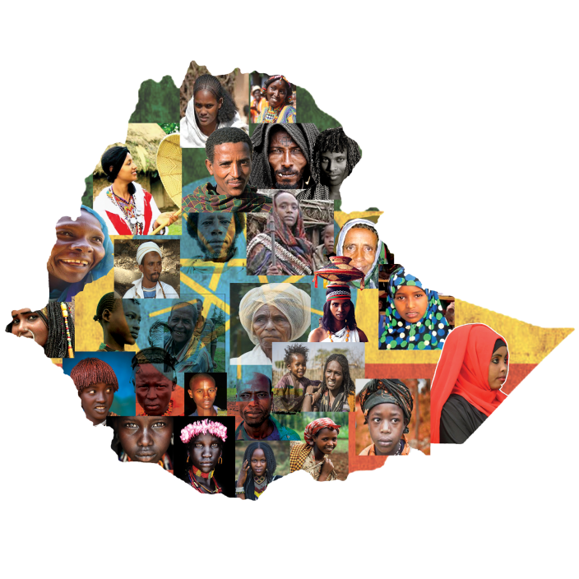
Human resources slide 1
UNREACHED PEOPLE GROUPS

Slide 2
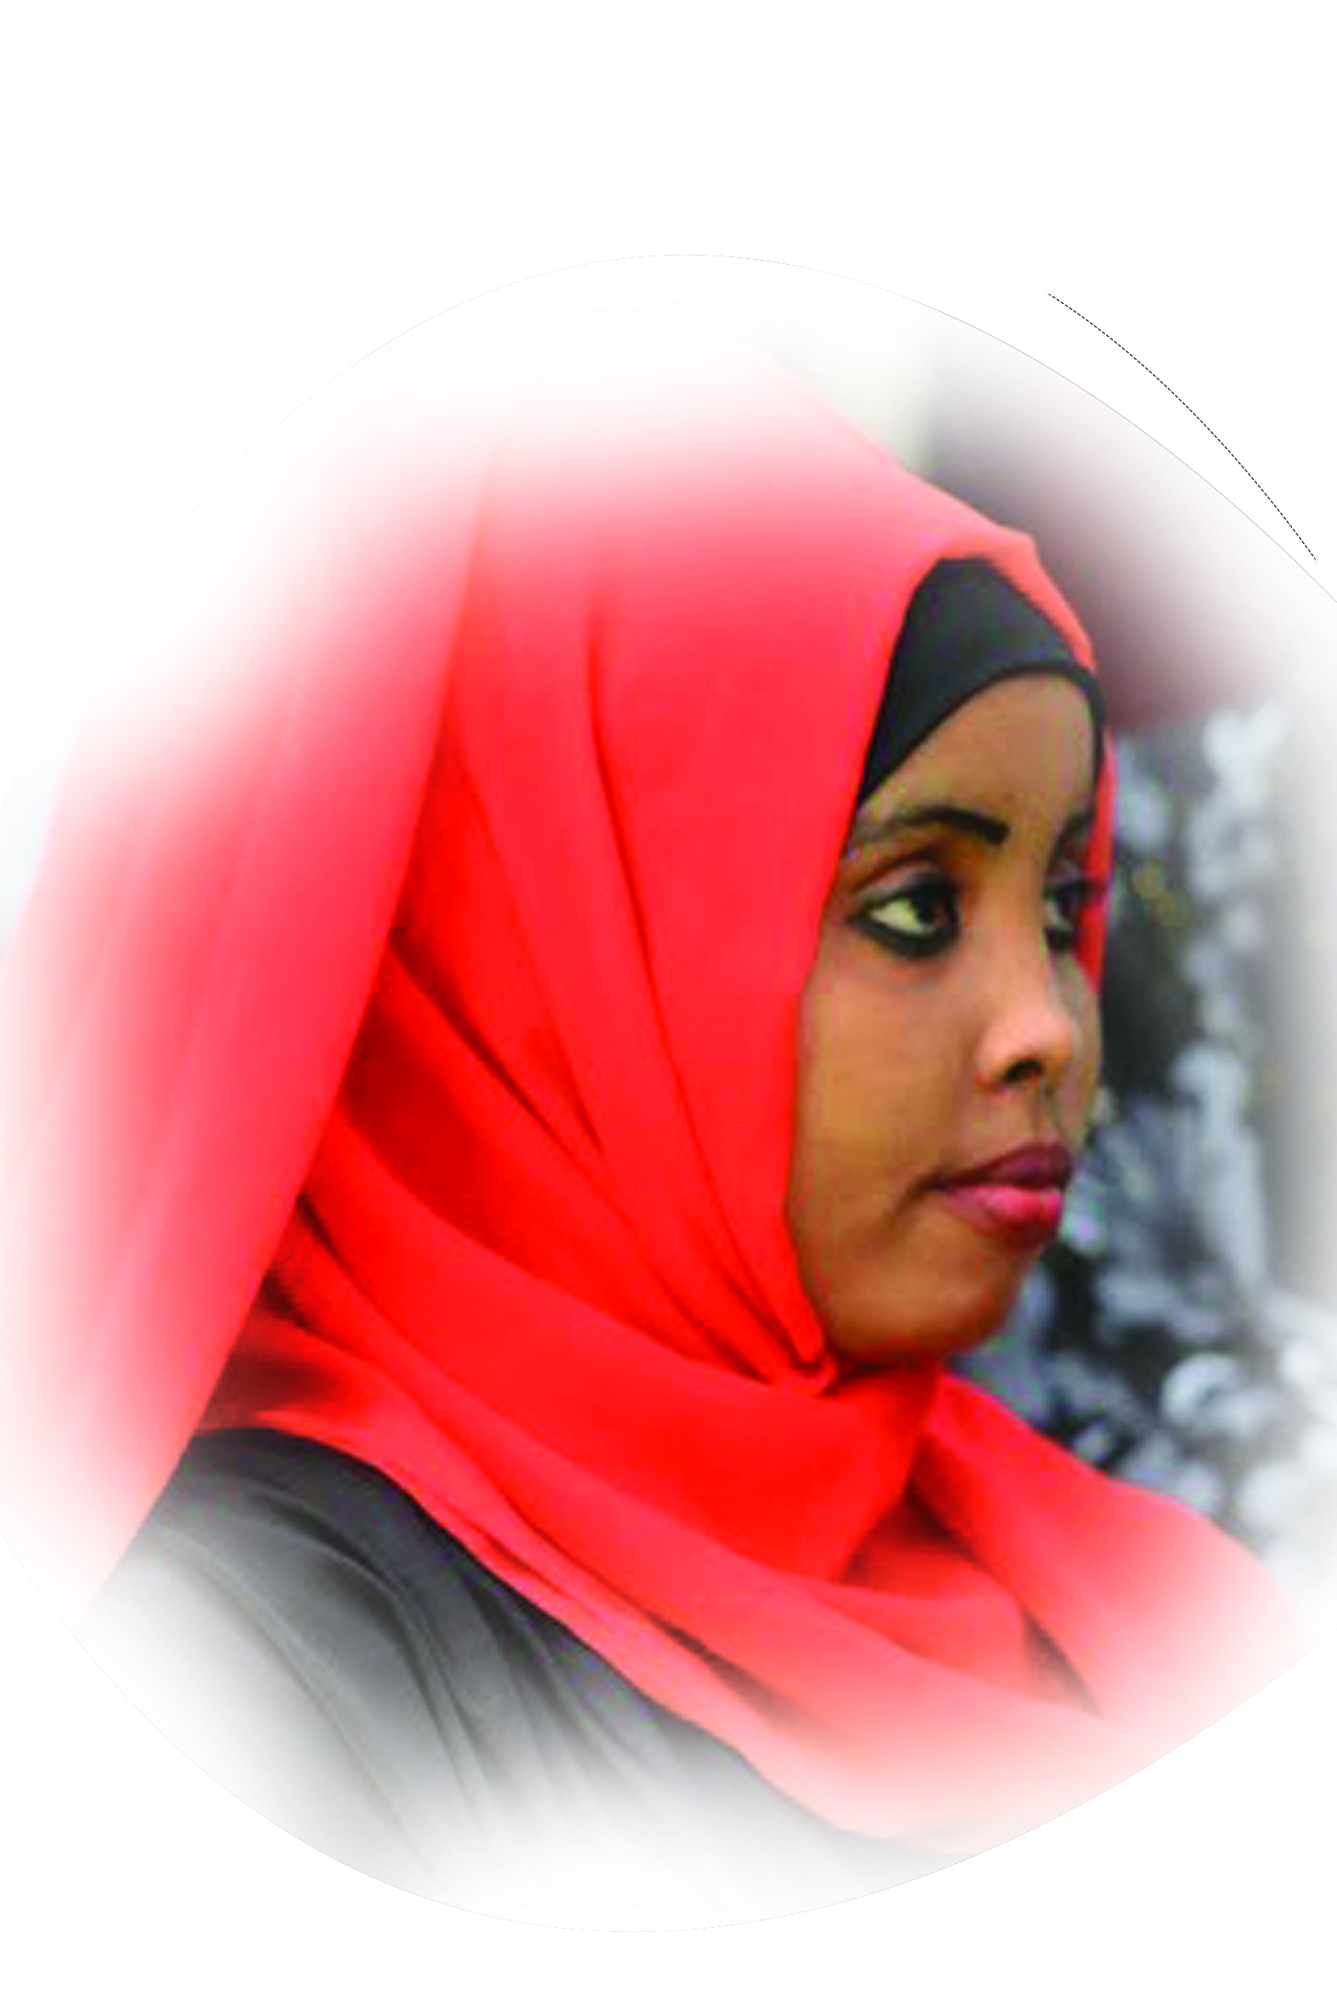
Human resources slide 2
SOMALI
People group፡ | Somali
Location ፡ | East Ethiopia
Population፡ | 23,116,600
Main Language ፡ | Somali
Main Religion፡ | Islam
Christian % ፡ | 0.14%
Evangelical % ፡ | 0.03%
Bible ፡ | Yes
Jesus Film ፡ | Yes
Genesis 12:1-3

Slide 3
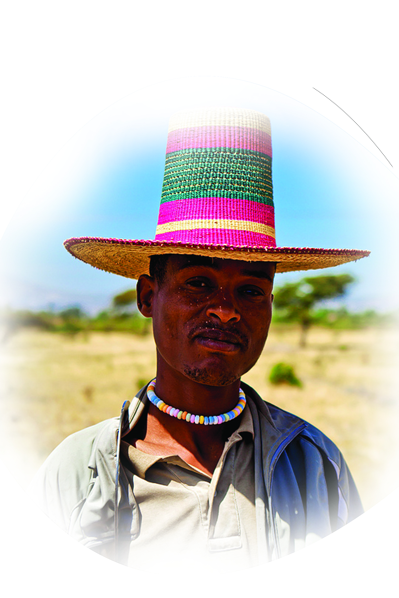
ALABA
People group፡ | Alaba
Location ፡ | South Ethiopia
Population፡ | 371,000
Main Language ፡ | Alaba
Main Religion፡ | Islam
Christian % ፡ | 2.6%
Evangelical % ፡ | 1.4%
Bible ፡ | Portion
Jesus Film ፡ | Yes
Psalm 102:10

Slide 4
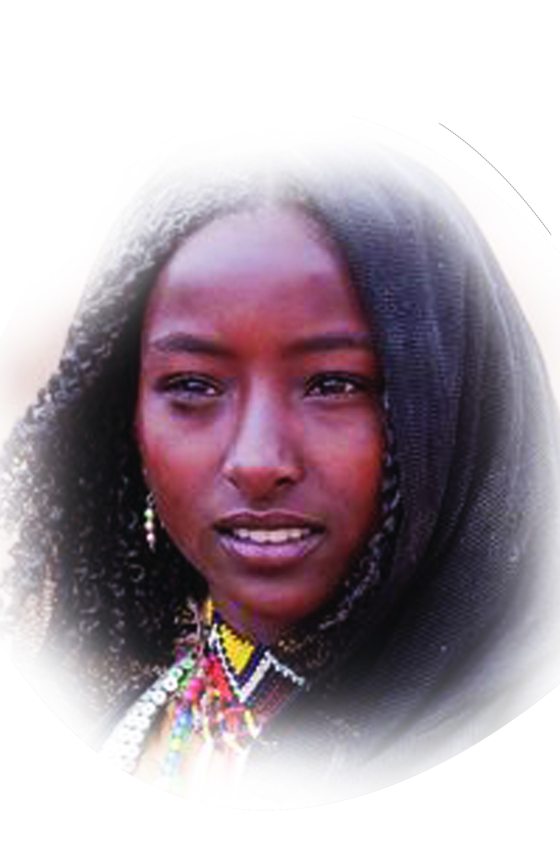
NUBIA
People group፡ | Nubia
Location ፡ | Sudan
Population፡ | 75,000
Main Language ፡ | Andadi
Main Religion፡ | Ethnic
Christian % ፡ | 0%
Evangelical % ፡ | 0%
Bible ፡ | No
Jesus Film ፡ | No
Exodus 9:15-16

Slide 5
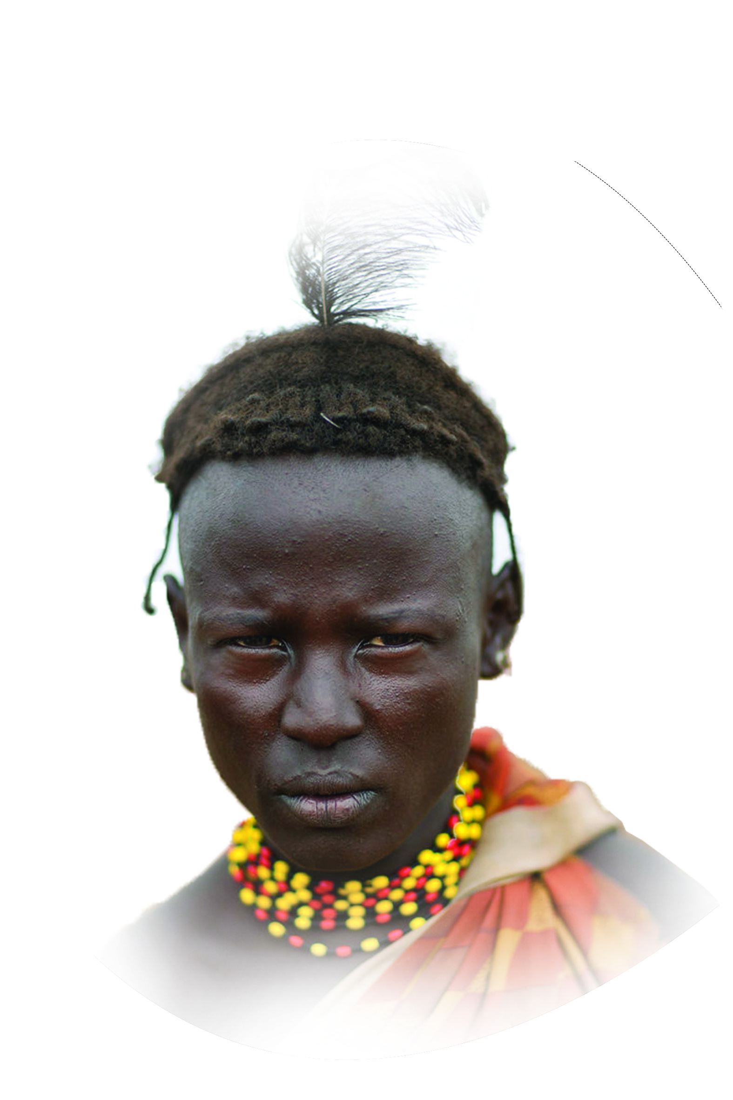
DA’SENECH
People group፡ | Da’senech
Location ፡ | South-Omo Ethiopia
Population፡ | 96,600
Main Language ፡ | Da’senech
Main Religion፡ | Ethnic
Christian % ፡ | 1%
Evangelical % ፡ | 1%
Bible ፡ | New Testament
Jesus Film ፡ | Yes
Joshua 4:23-24

Slide 6
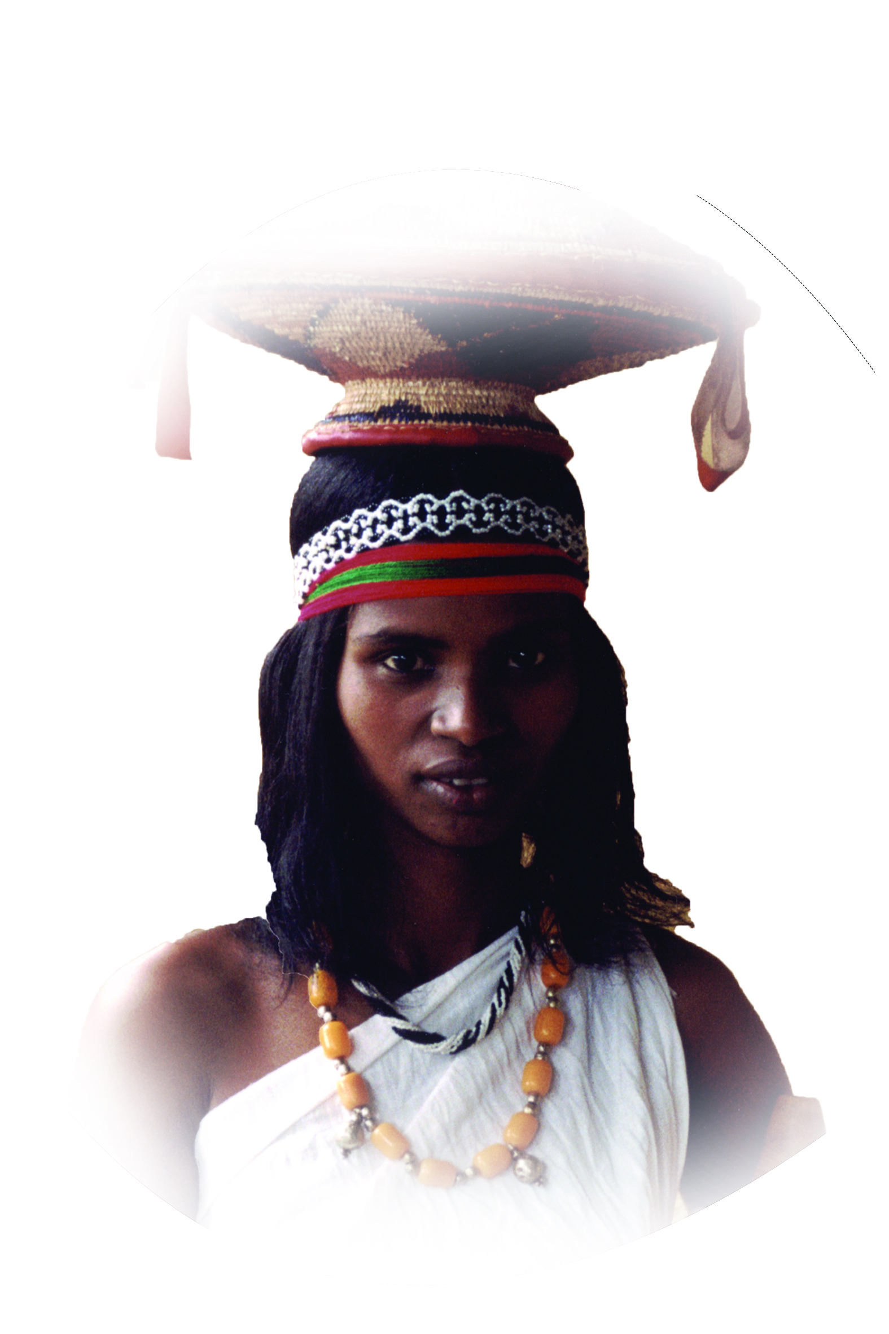
Harerge Oromo
People group፡ | Harerge Oromo
Location ፡ | East Ethiopia
Population፡ | 6,859,000
Main Language ፡ | Oromifa
Main Religion፡ | Islam
Christian % ፡ | 5%
Evangelical % ፡ | 0.05%
Bible ፡ | Portion
Jesus Film ፡ | Yes
1kings 8:41-43

Slide 7
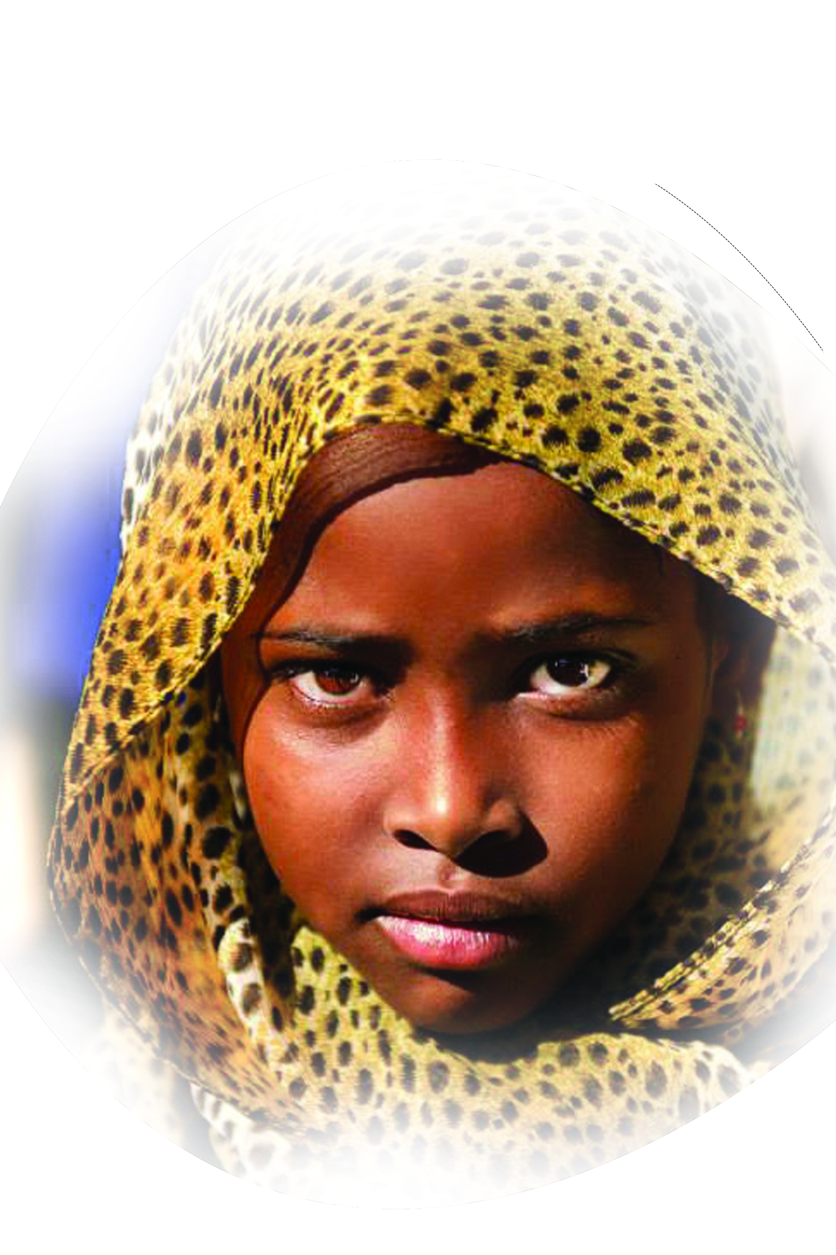
HARARI
People group፡ | Harari
Location ፡ | East Ethiopia
Population፡ | 49,000
Main Language ፡ | Haderigna
Main Religion፡ | Islam
Christian % ፡ | 0.3%
Evangelical % ፡ | 0.05%
Bible ፡ | Portion
Jesus Film ፡ | No
Malachi . 1:1

Slide 8
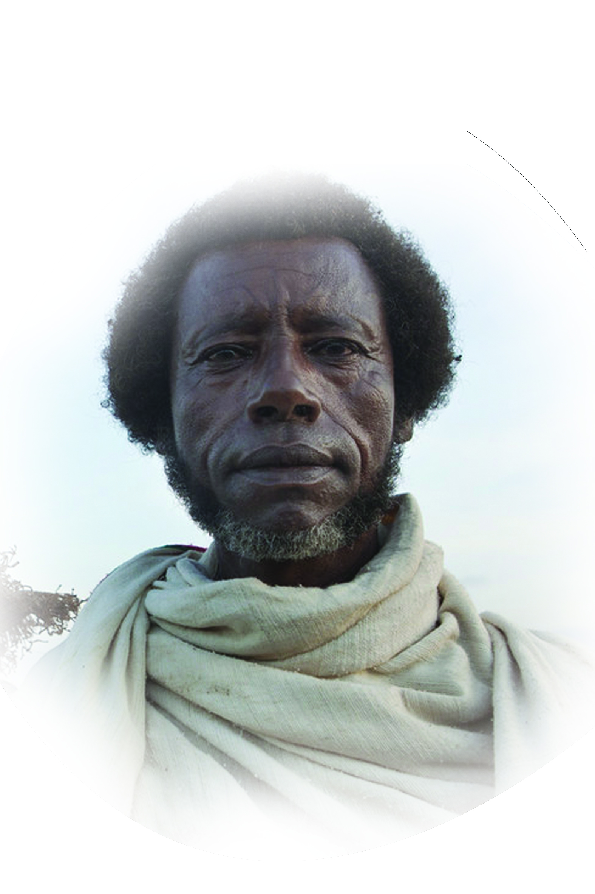
Psalm 9:11
KEREYU OROMO
People group፡ | Kereyu
Location ፡ | East Ethiopia
Population፡ | 96,000
Main Language ፡ | Oromigna
Main Religion፡ | Ethnic
Christian % ፡ | 2.5%
Evangelical % ፡ | 1.5%
Bible ፡ | Yes
Jesus Film ፡ | Yes

Slide 9
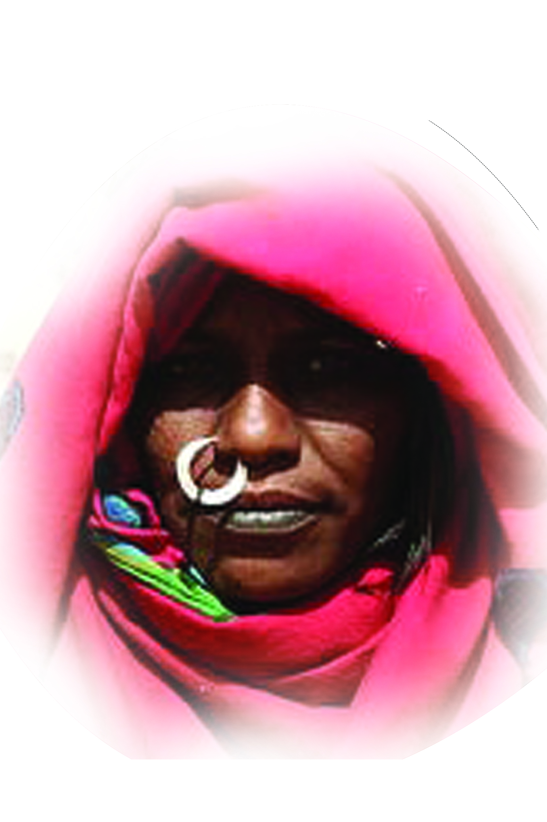
Mat, 28:19-20
KABABISH
People group፡ | Kababish
Location ፡ | Sudan
Population፡ | 415,000
Main Language ፡ | Sudanese Arabic
Main Religion፡ | Islam
Christian % ፡ | 0%
Evangelical % ፡ | 0%
Bible ፡ | No
Jesus Film ፡ | No

Slide 10
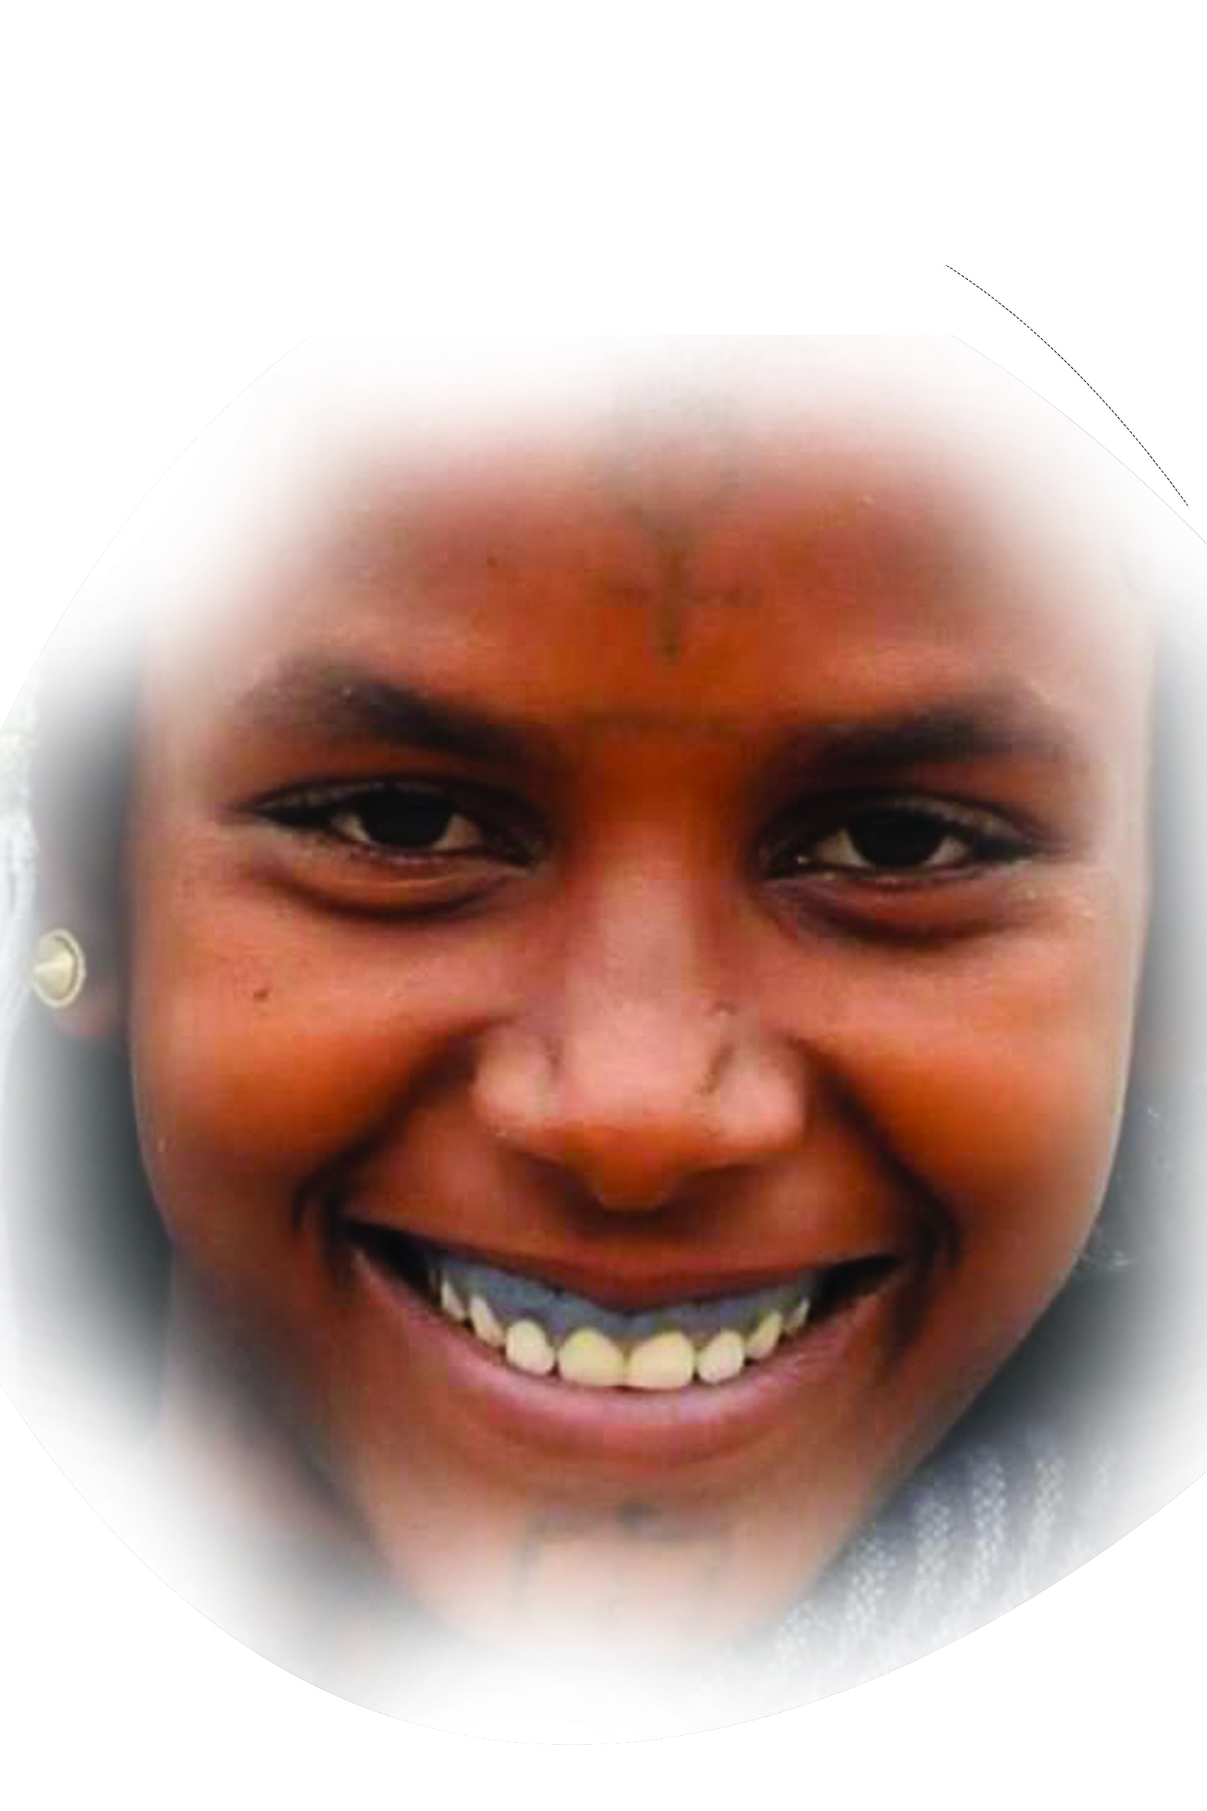
AGEW
People group፡ | Agew
Location ፡ | North Ethiopia
Population፡ | 1,076,878
Main Language ፡ | Agew, Amharic, Tigrigna
Main Religion፡ | Christian
Christian % ፡ | 96%
Evangelical % ፡ | 0.4%
Bible ፡ | Yes
Jesus Film ፡ | Yes
Rev 7:9-10

Slide 11
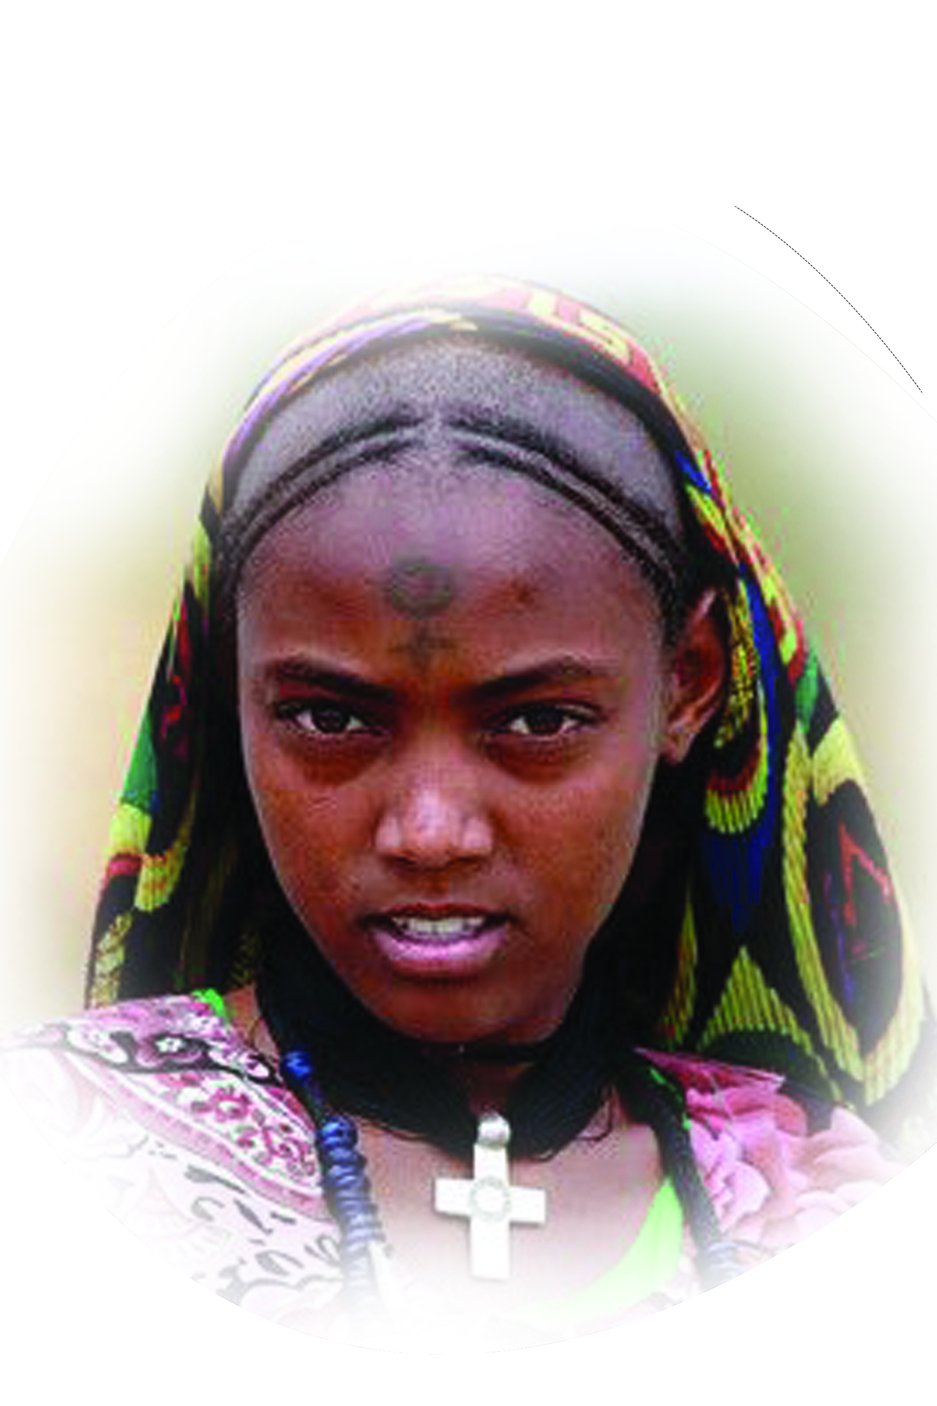
TIGRAWAY
People group፡ | Tigraway
Location ፡ | North Ethiopia
Population፡ | 4,486,513
Main Language ፡ | Tigrigna
Main Religion፡ | Christian
Christian % ፡ | 96.44%
Evangelical % ፡ | 0.3%
Bible ፡ | Yes
Jesus Film ፡ | Yes
Rev, 5:9-10

Slide 12
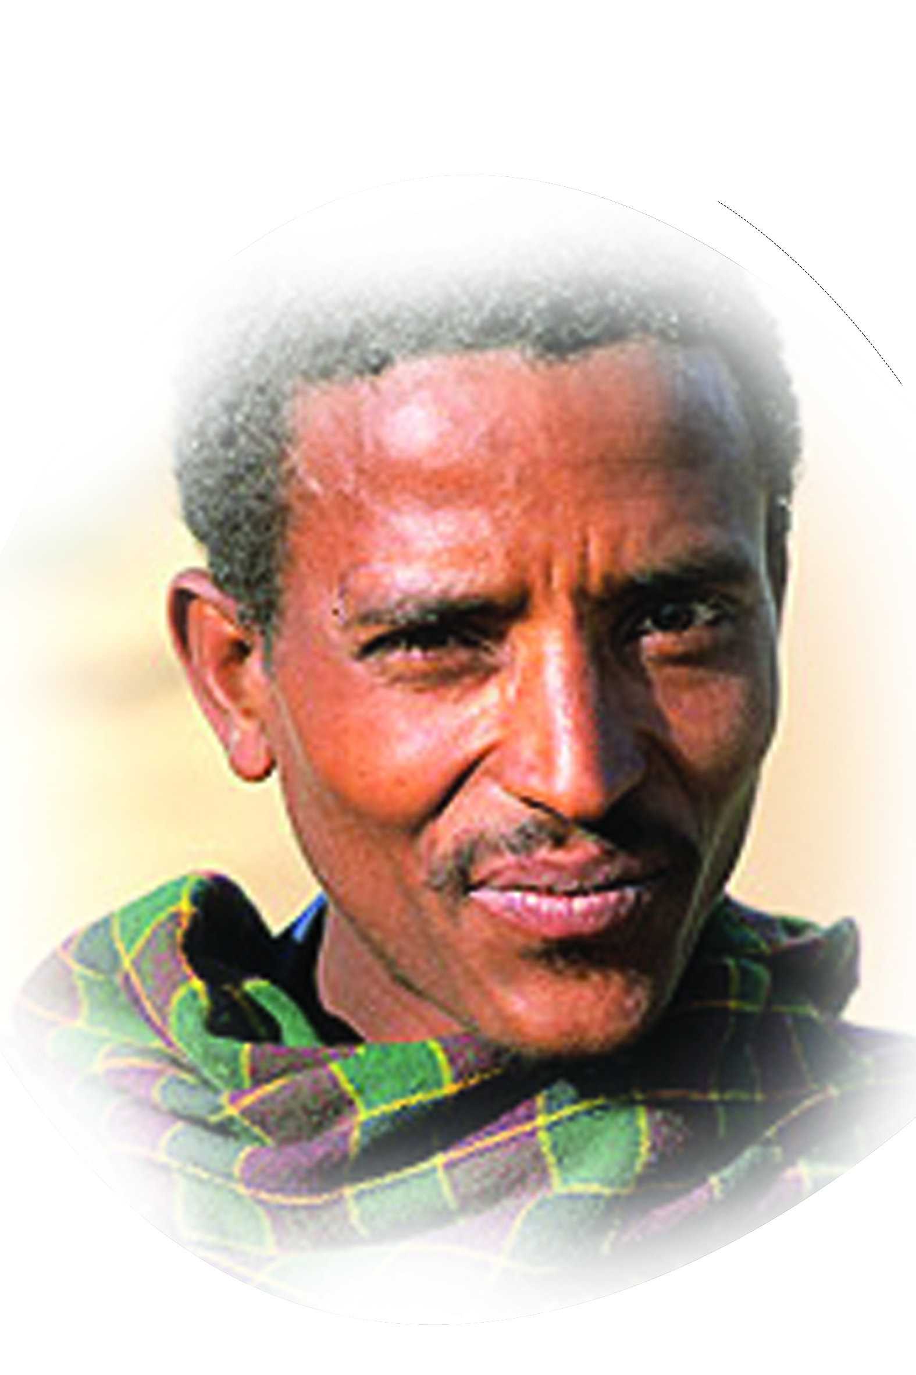
Amhara
People group፡ | Amhara
Location ፡ | North Ethiopia
Population፡ | 19,878,191
Main Language ፡ | Amharic
Main Religion፡ | Christian
Christian % ፡ | 84.9%
Evangelical % ፡ | 1.1%
Bible ፡ | Yes
Jesus Film ፡ | Yes
Dan, 3:28-29

Slide 13
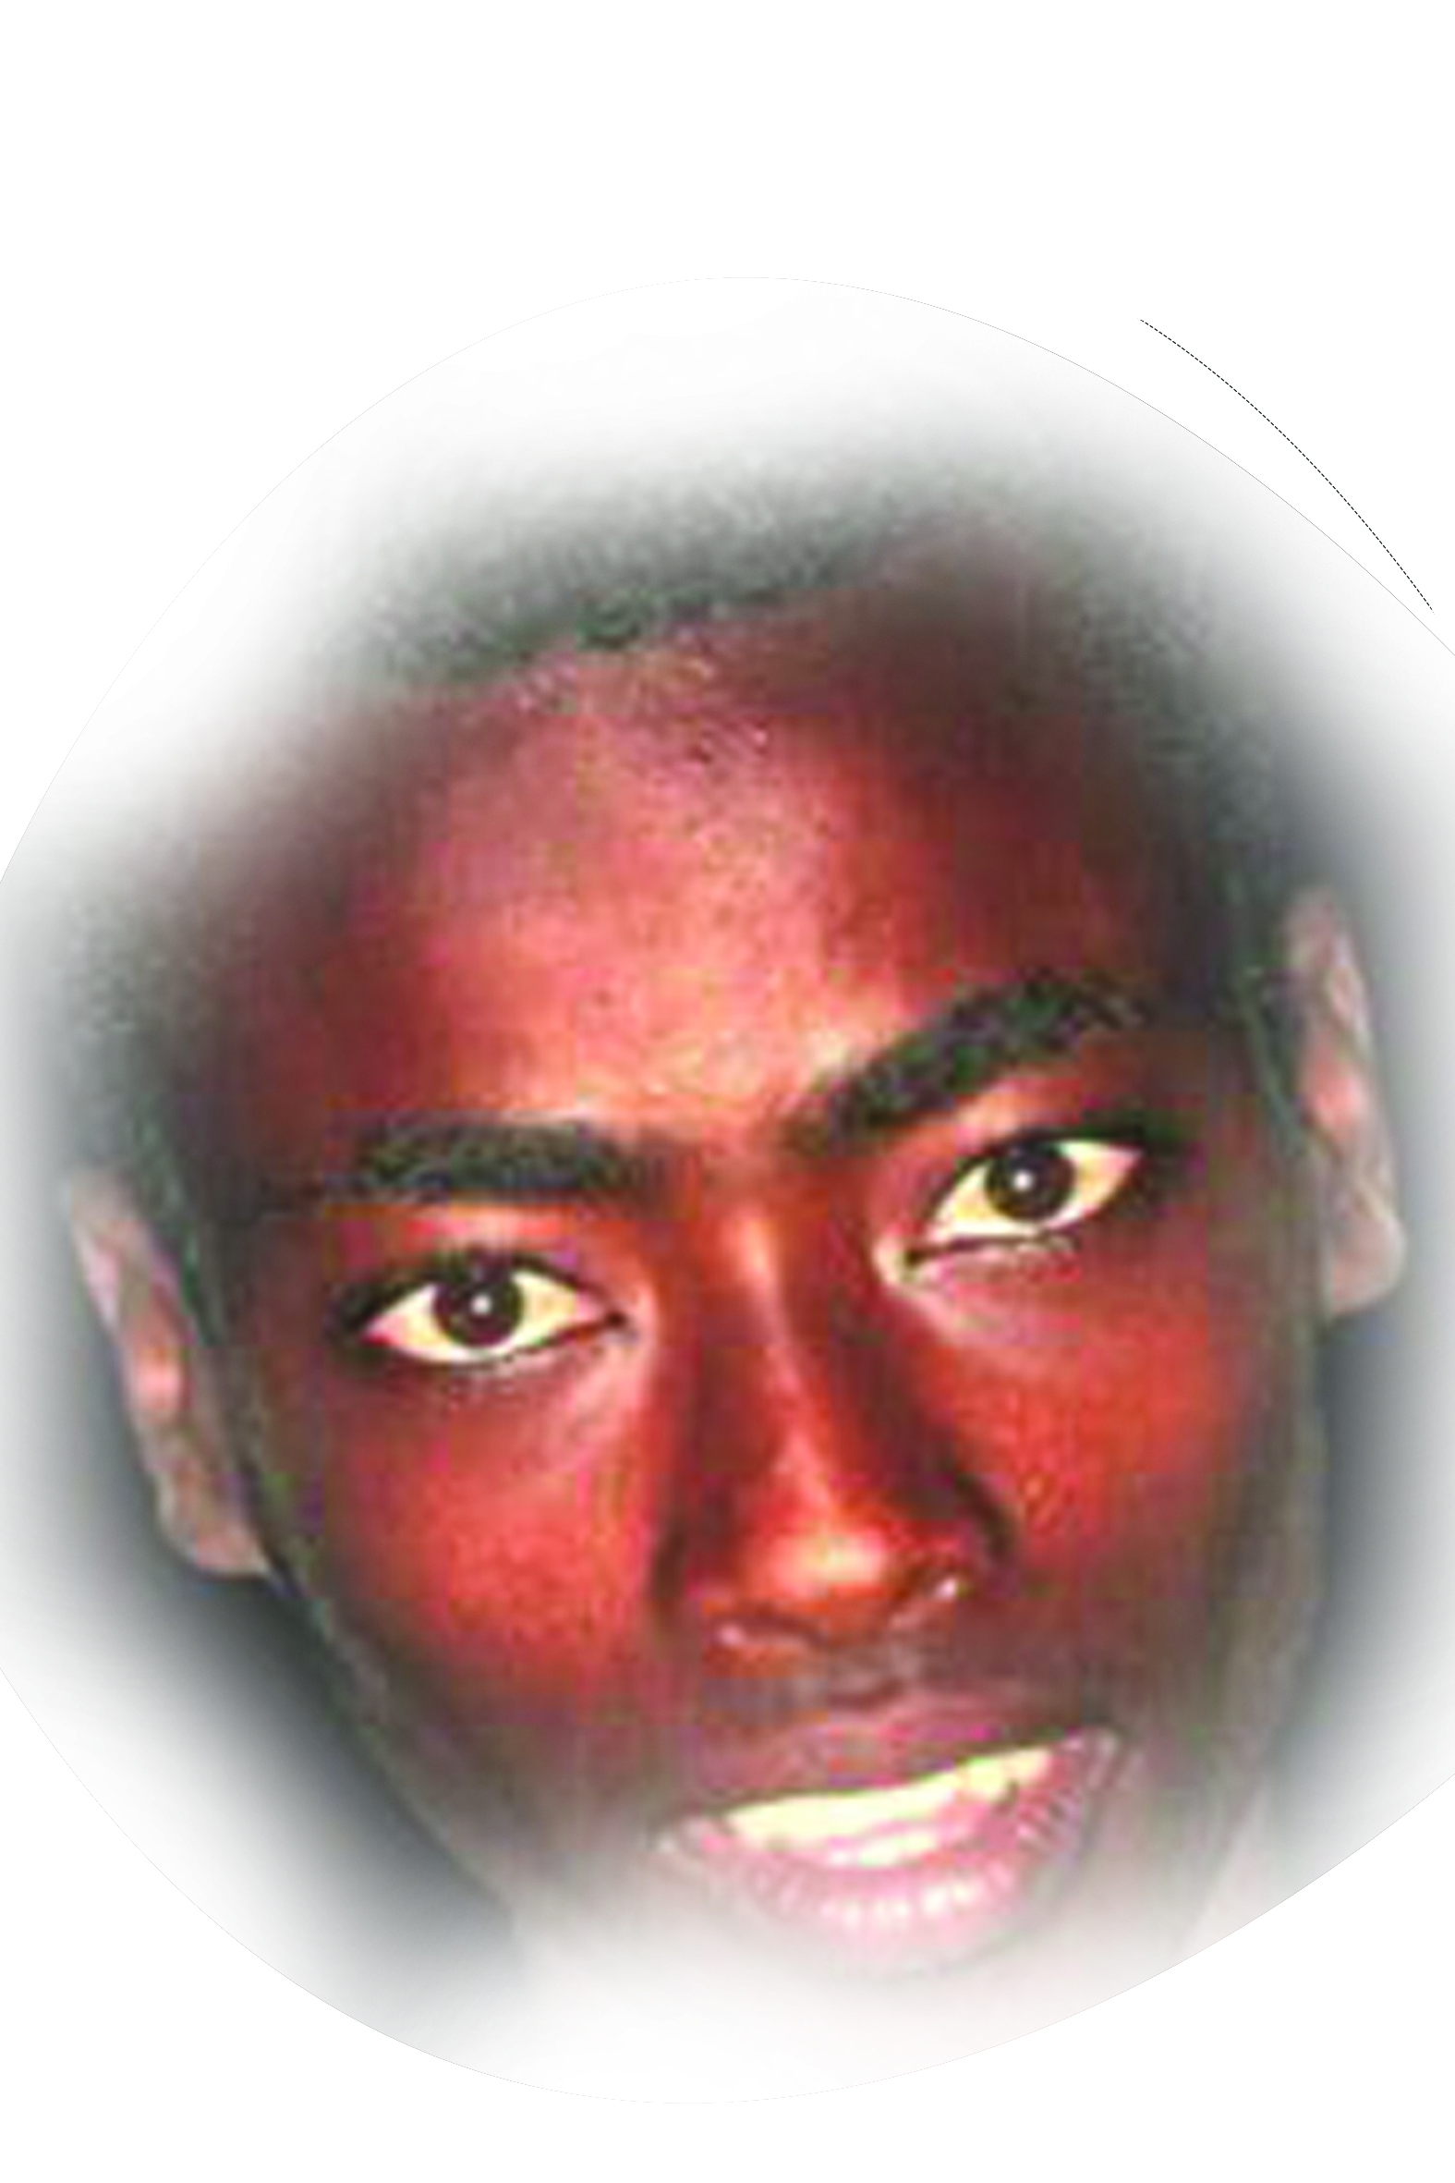
Zeyise፡ Zergulla
People group፡ | Zeyise, Zergulla
Location ፡ | South Ethiopia
Population፡ | 17,889
Main Language ፡ | Zayisit
Main Religion፡ | Ethnic
Christian % ፡ | 1.9%
Evangelical % ፡ | 1.6%
Bible ፡ | No
Jesus Film ፡ | No
Isaiah 49፡6

Slide 14
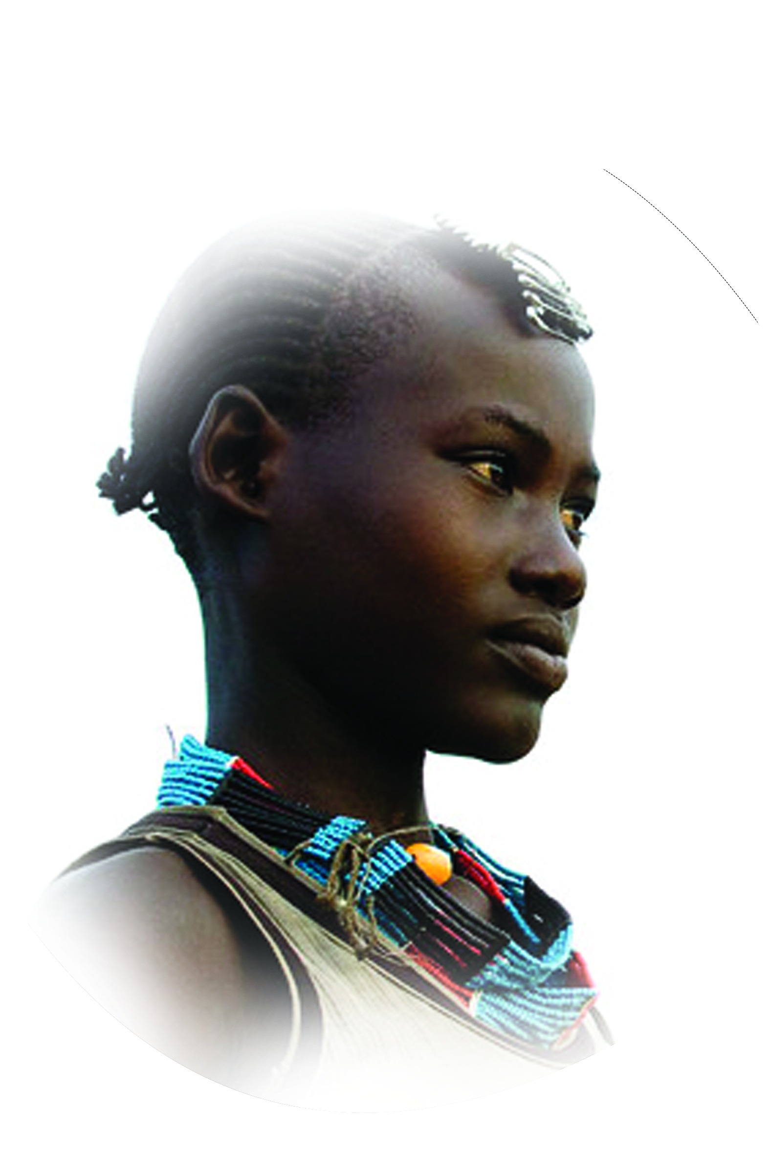
Tsemay
People group፡ | Tsemay
Location ፡ | South-Omo Ethiopia
Population፡ | 20,045
Main Language ፡ | Tsemay
Main Religion፡ | Ethnic
Christian % ፡ | 2%
Evangelical % ፡ | 1.5%
Bible ፡ | On Translation
Jesus Film ፡ | No
Psalm 2:8

Slide 15
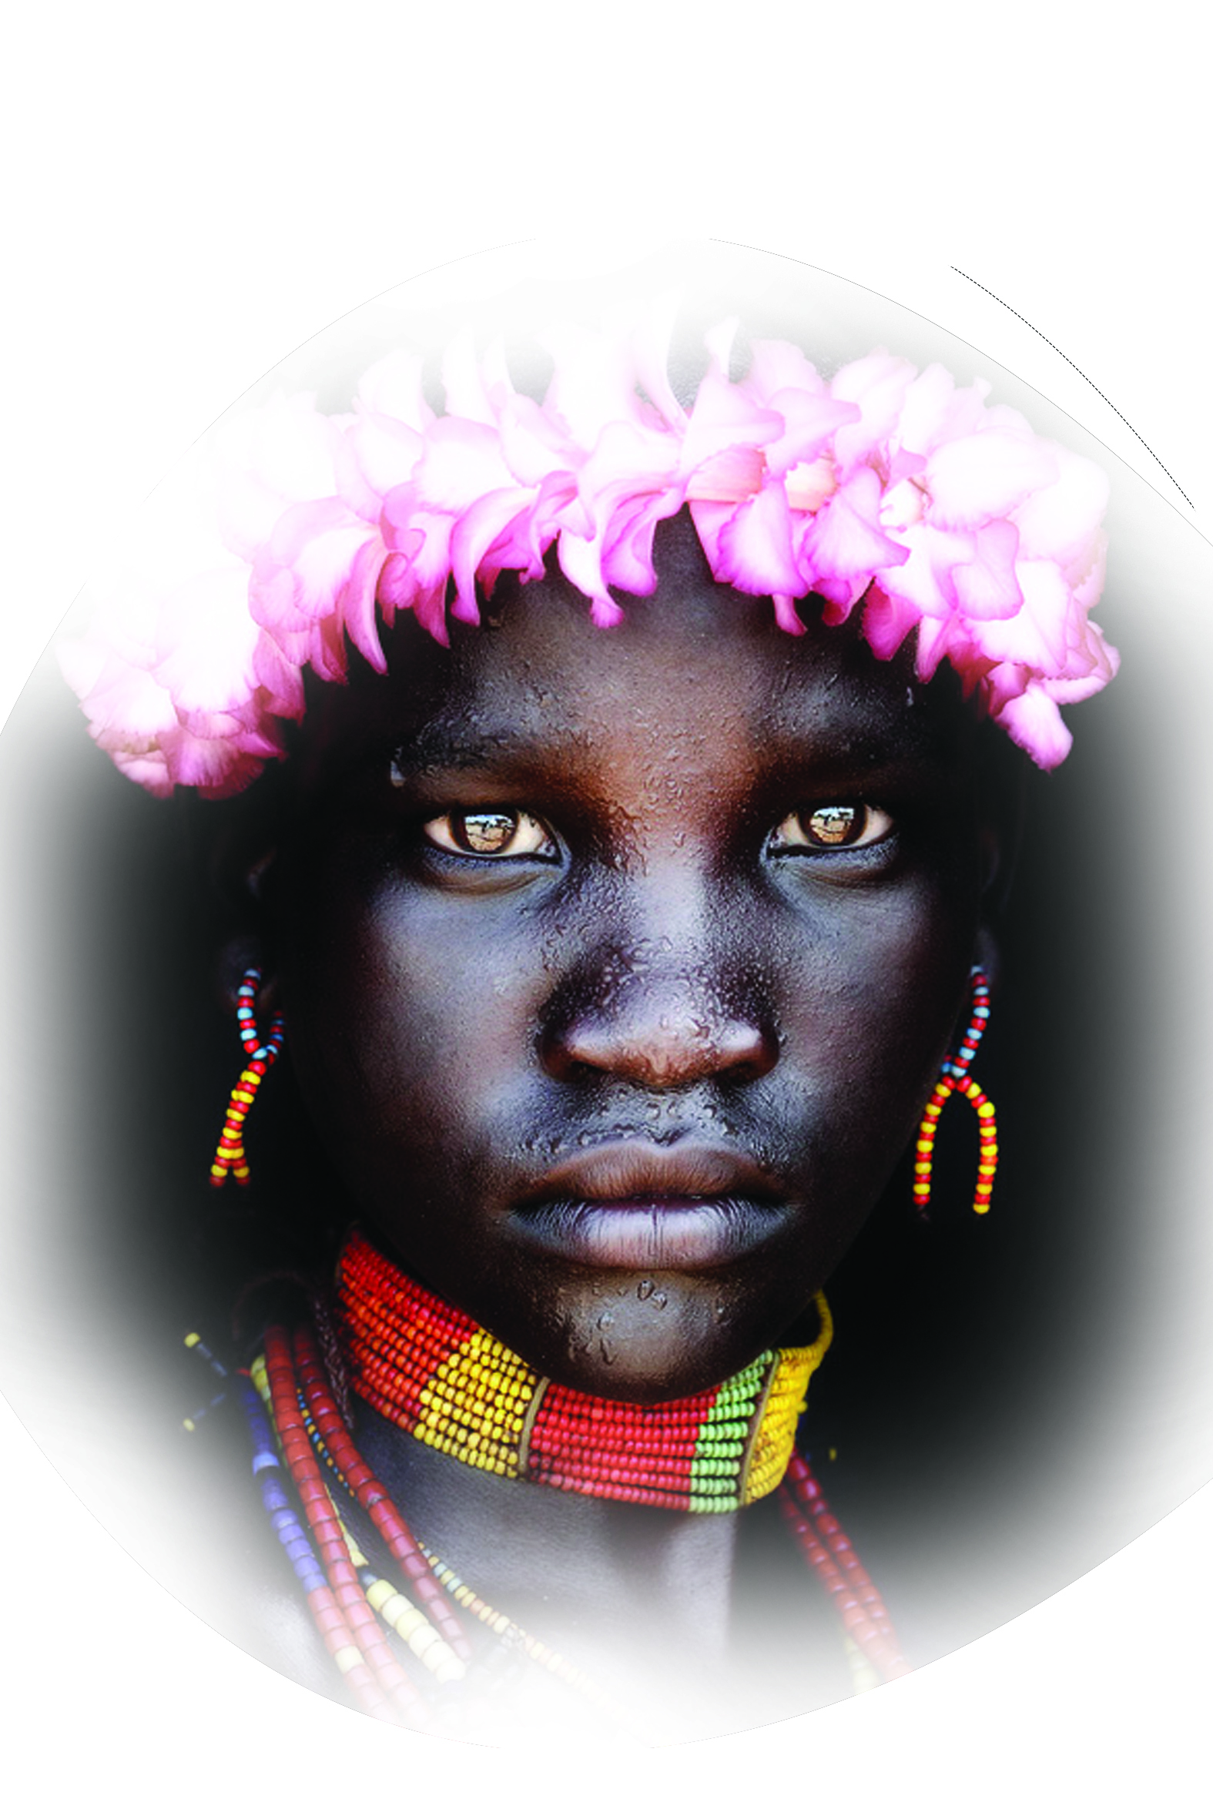
KARO
People group፡ | Karo
Location ፡ | South Ethiopia
Population፡ | 2,300
Main Language ፡ | Karo
Main Religion፡ | Ethnic
Christian % ፡ | 0.70%
Evangelical % ፡ | 0.70%
Bible ፡ | No
Jesus Film ፡ | No
Psalm 108:1-5

Slide 16
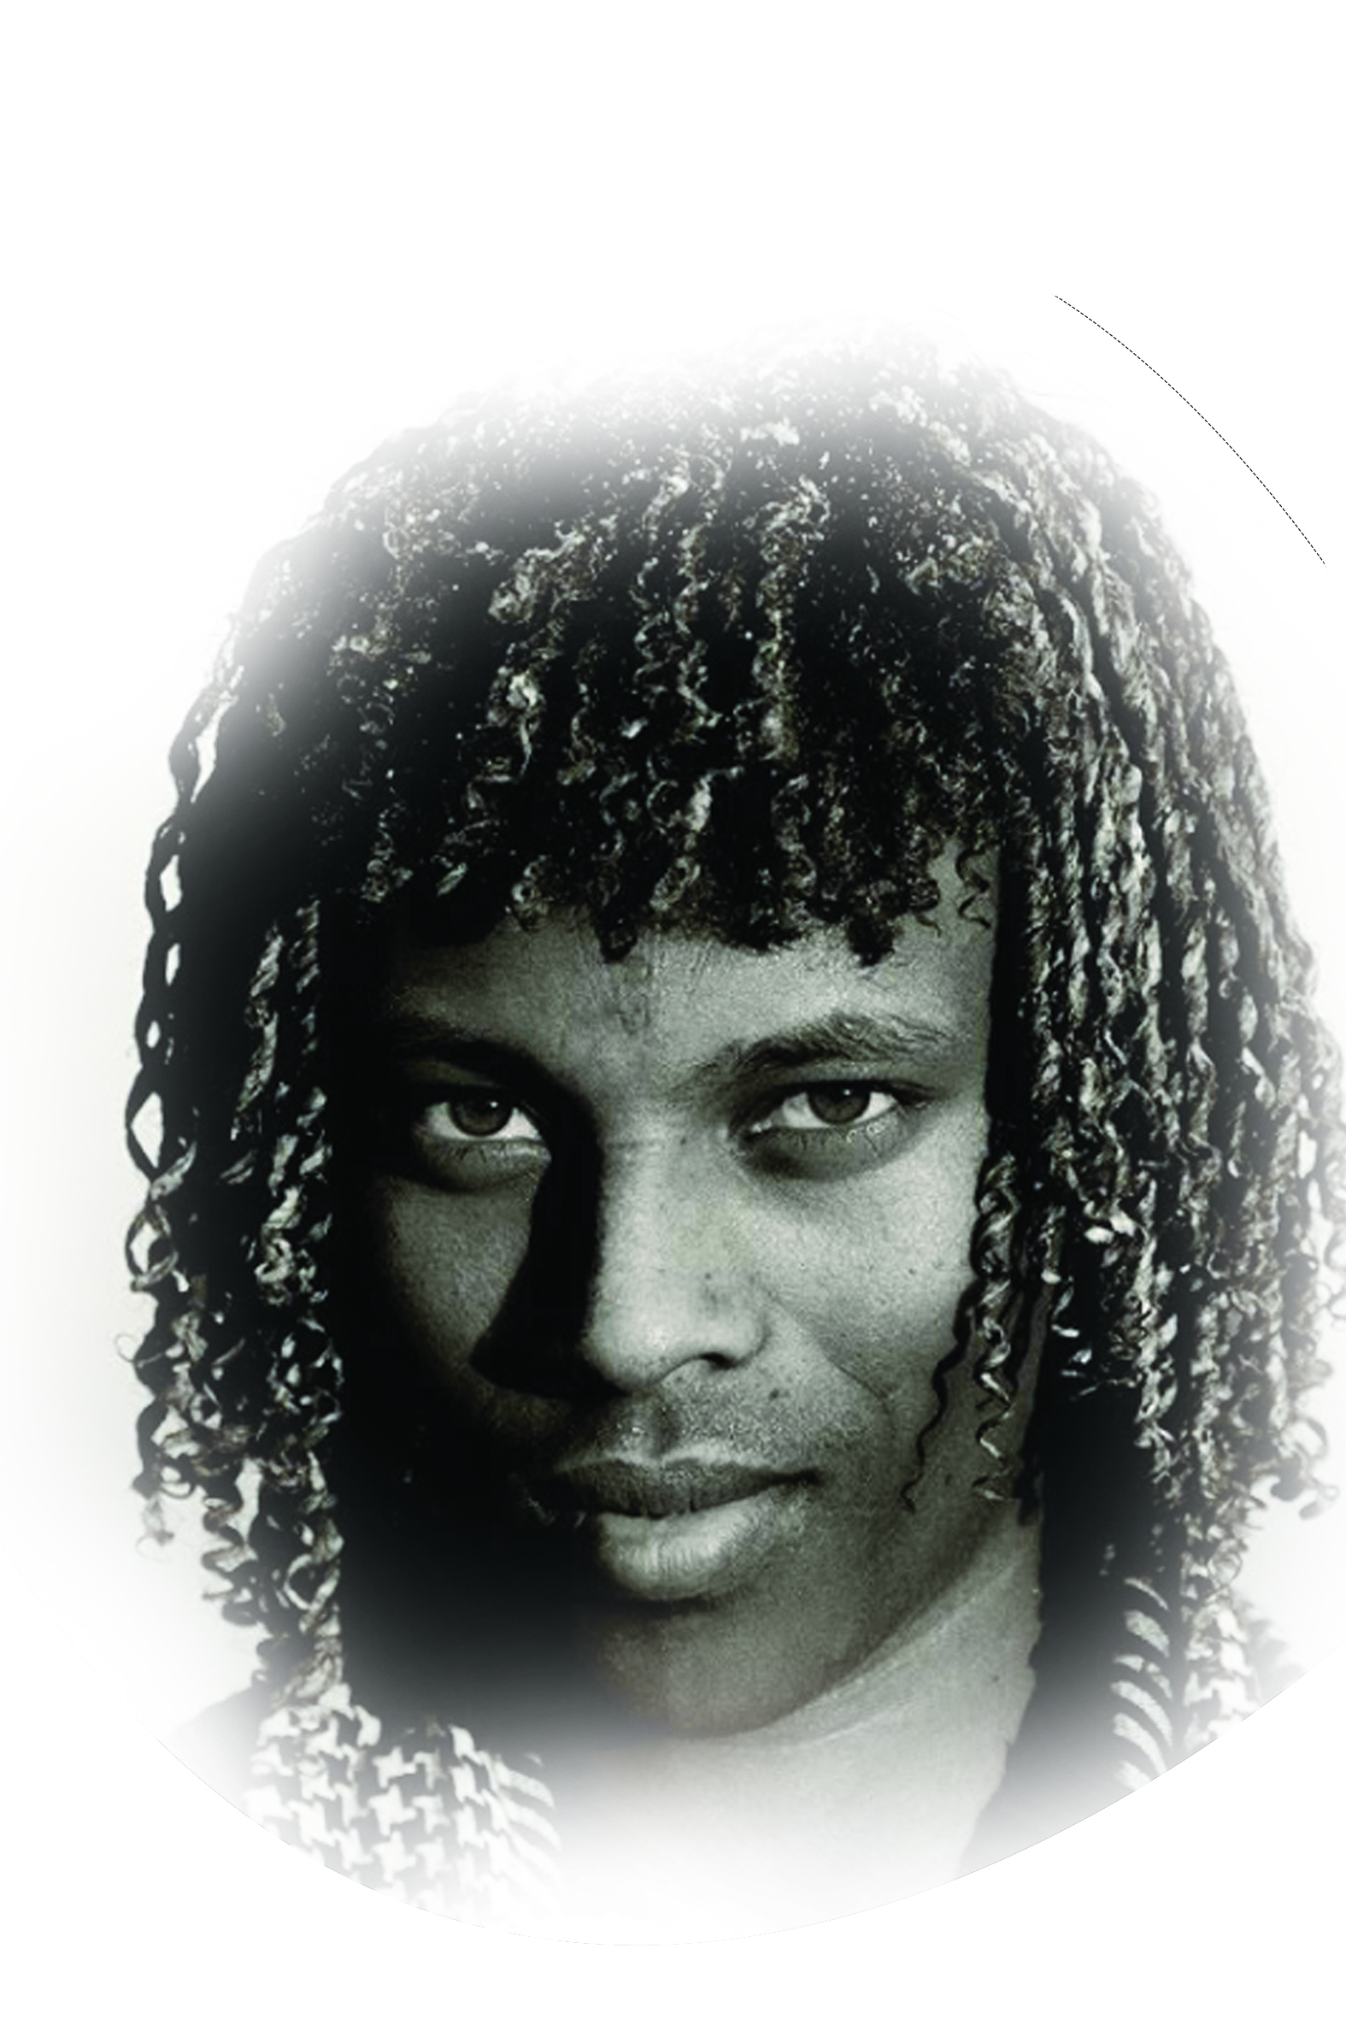
Gen 18:18
AFAR
People group፡ | Afar
Location ፡ | North East Ethiopia
Population፡ | 2,492,000
Main Language ፡ | Afar
Main Religion፡ | Islam
Christian % ፡ | 4.6%
Evangelical % ፡ | 0.08%
Bible ፡ | Yes
Jesus Film ፡ | yes

Slide 17
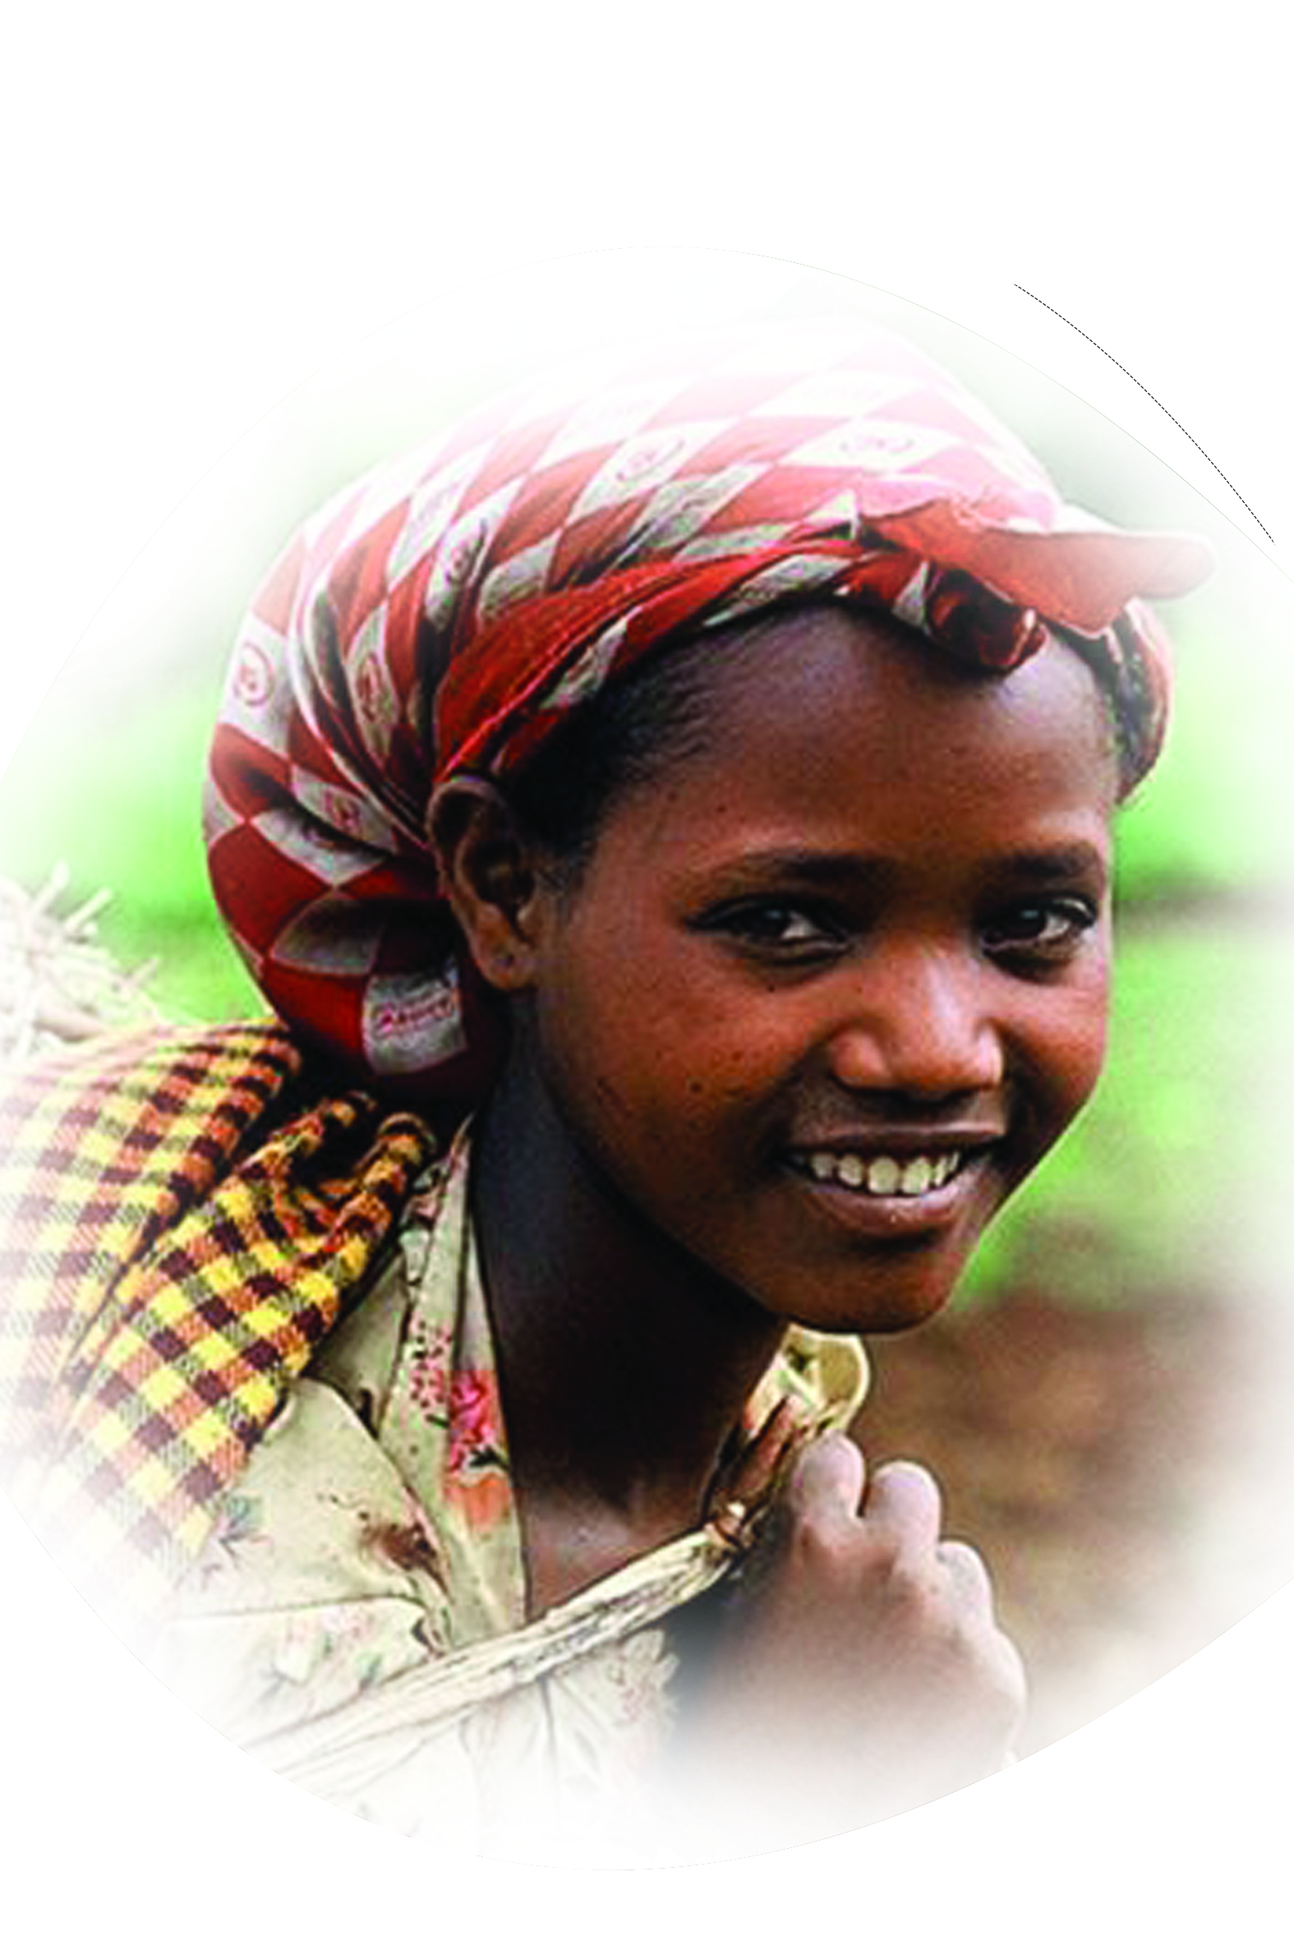
Psalm 105:1
NAO
People group፡ | Nao
Location ፡ | South Ethiopia
Population፡ | 16,000
Main Language ፡ | Nayi
Main Religion፡ | Ethnic
Christian % ፡ | 10%
Evangelical % ፡ | 0.9%
Bible ፡ | On translation
Jesus Film ፡ | No

Slide 18
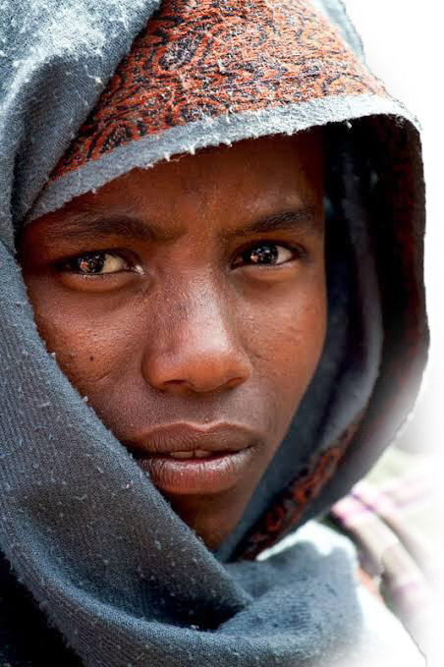
Psalm 99:1-3
WELLO
People group፡ | Wello
Location ፡ | North Ethiopia
Population፡ | 5,751,000
Main Language ፡ | Amharic
Main Religion፡ | Islam
Christian % ፡ | 2.90%
Evangelical % ፡ | 0.20%
Bible ፡ | Yes
Jesus Film ፡ | Yes

Slide 19
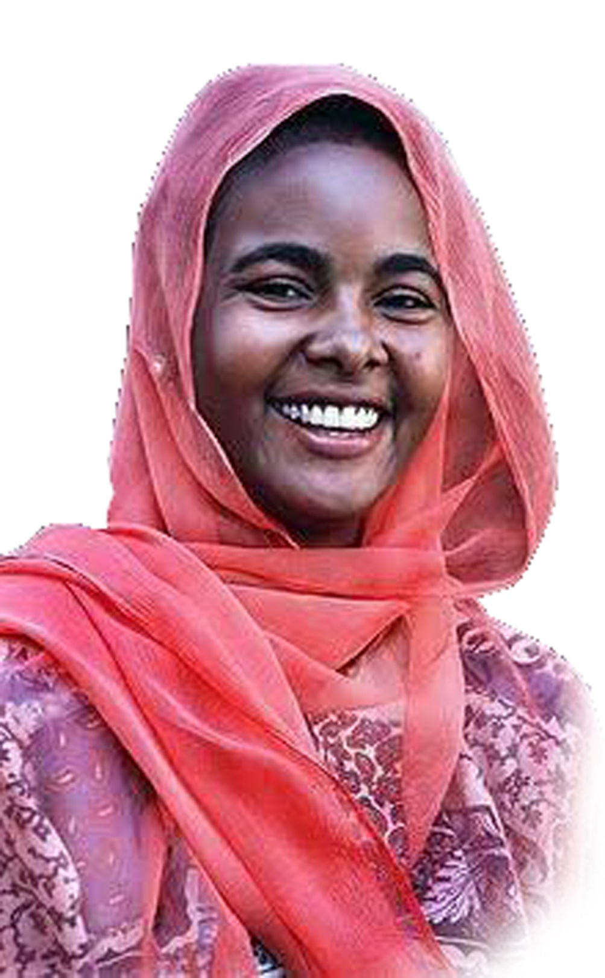
Psalm 98:1-9
ARAB, SUDAN
People group፡ | Sudan, Arab
Location ፡ | Sudan
Population፡ | 19,772,900
Main Language ፡ | Arabic
Main Religion፡ | Islam
Christian % ፡ | 3.00%
Evangelical % ፡ | 0.50%
Bible ፡ | New testament
Jesus Film ፡ | yes

Slide 20
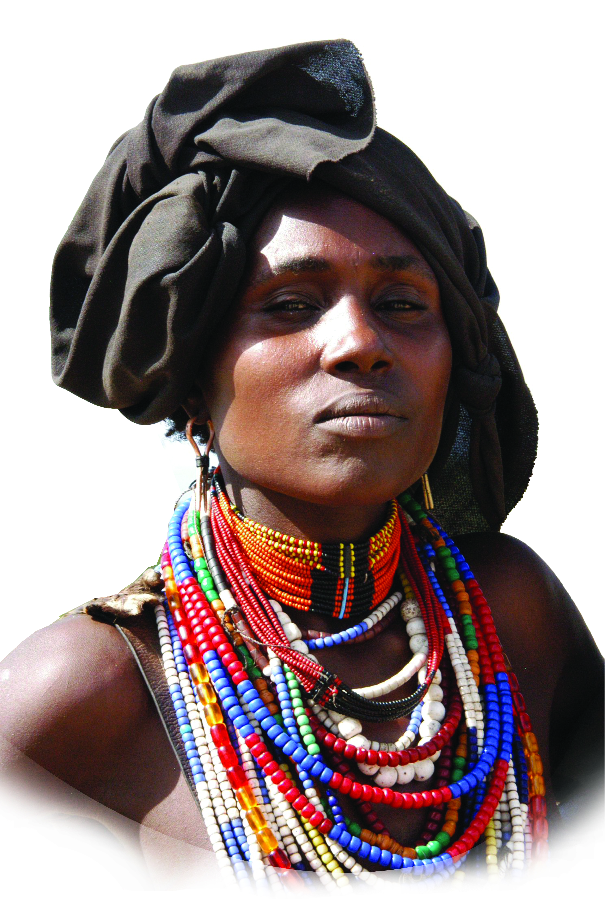
Mark 24:14
ARBORE
People group፡ | Arbore
Location ፡ | South Ethiopia
Population፡ | 11,000
Main Language ፡ | Arbore
Main Religion፡ | Ethnic
Christian % ፡ | 1.30%
Evangelical % ፡ | 1.30%
Bible ፡ | Portion
Jesus Film ፡ | No

Slide 21
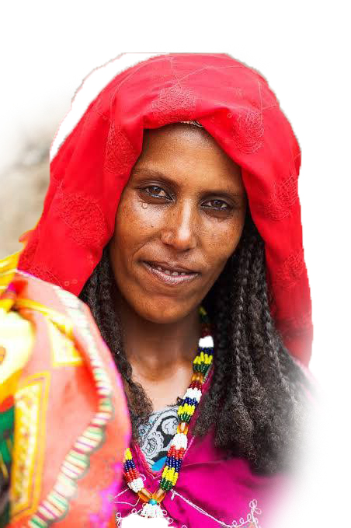
Mark 11:17
ARGOBA
People group፡ | Argoba
Location ፡ | North East Ethiopia
Population፡ | 201,000
Main Language ፡ | Argoba
Main Religion፡ | Islam
Christian % ፡ | 4.60%
Evangelical % ፡ | 1.40%
Bible ፡ | Portion
Jesus Film ፡ | No

Slide 22
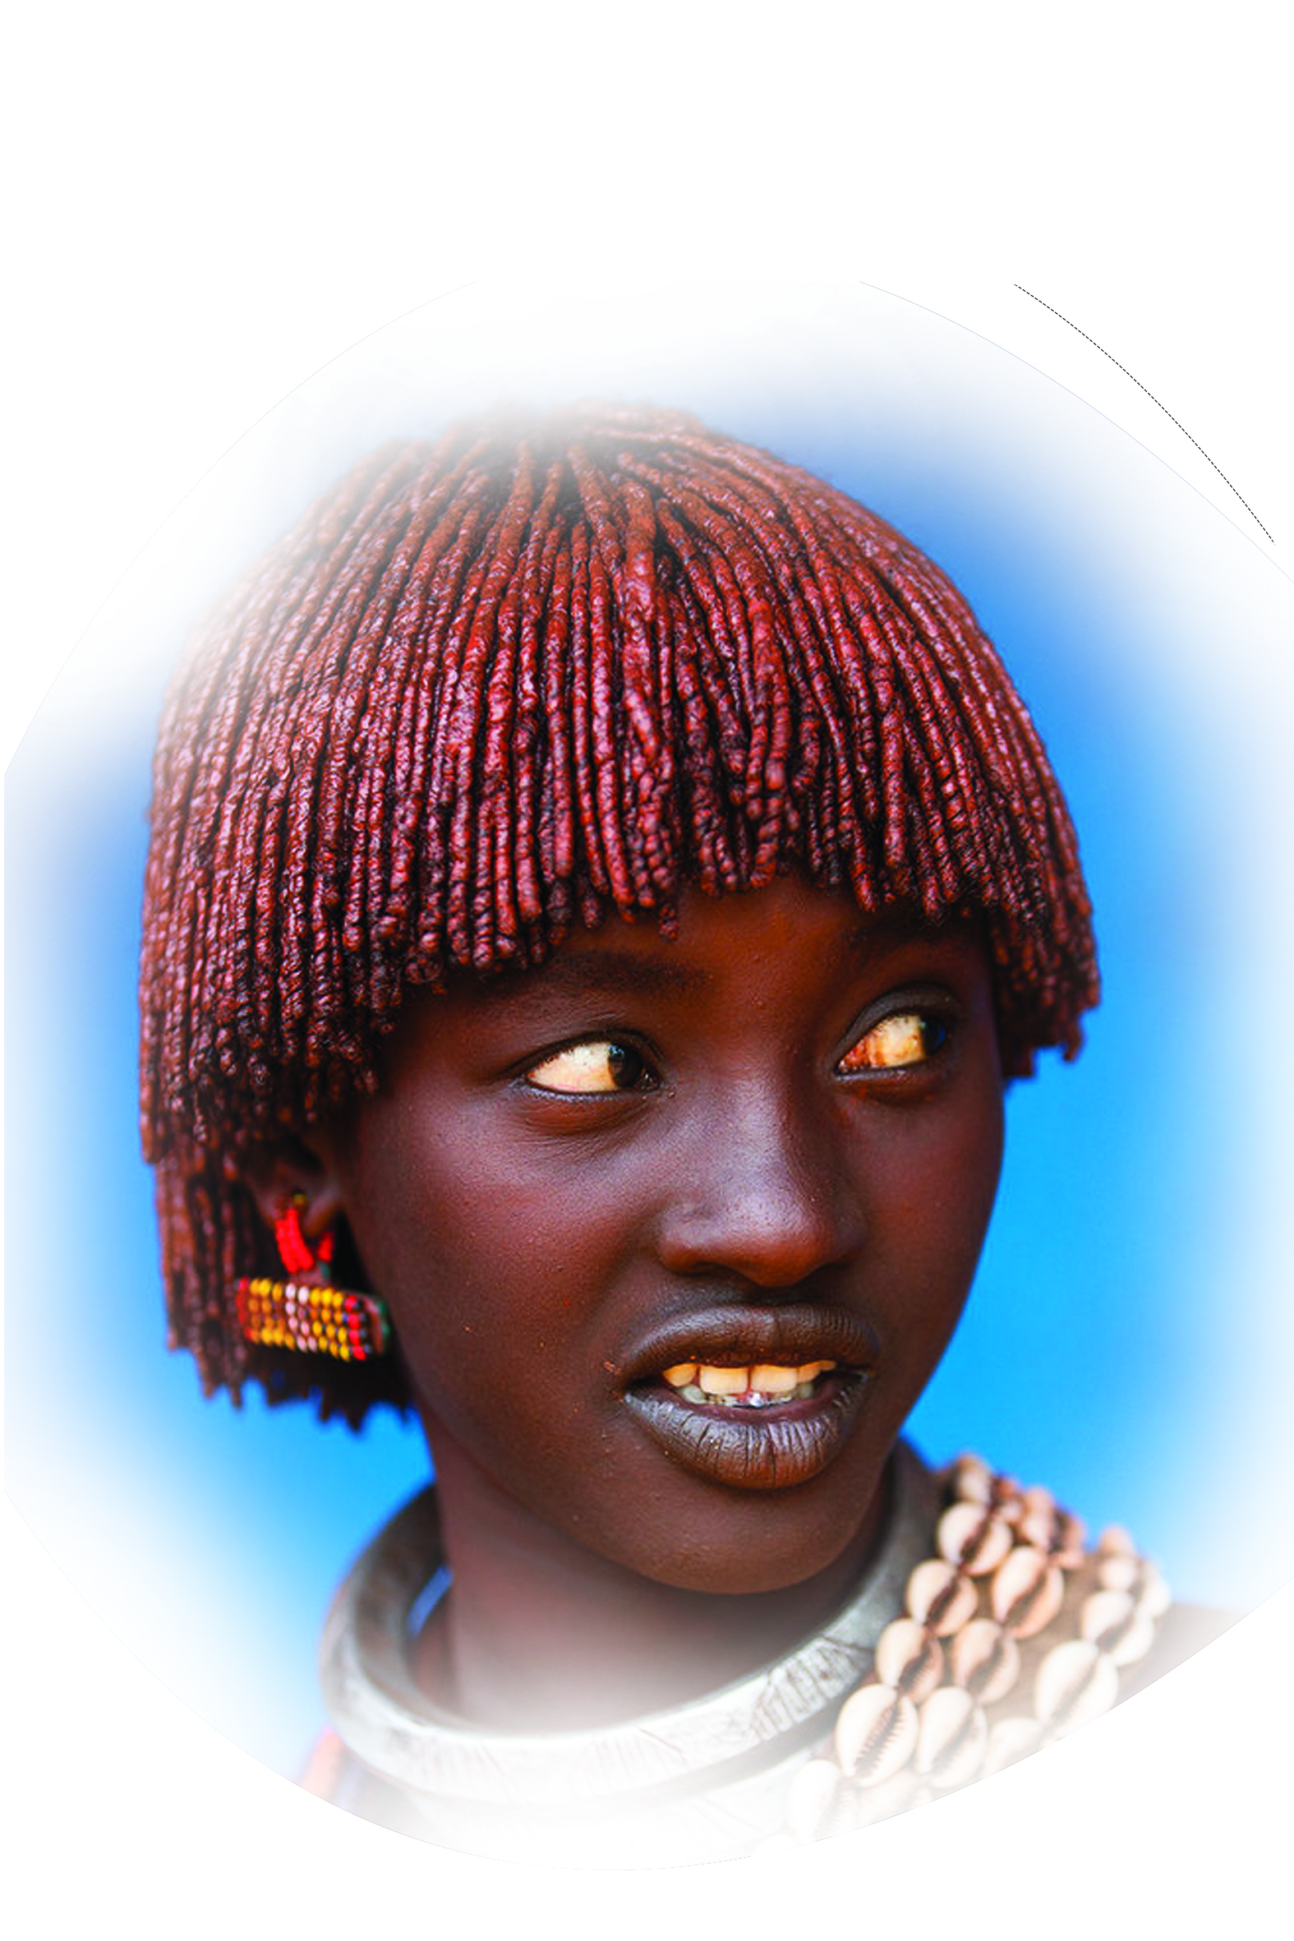
Psalm 96:1-13
HAMER- BENA
People group፡ | Hamer-Bena
Location ፡ | South-Omo Ethiopia
Population፡ | 74,000
Main Language ፡ | Hamer-Bena
Main Religion፡ | Ethnic
Christian % ፡ | 1.50%
Evangelical % ፡ | 1.30%
Bible ፡ | New statement
Jesus Film ፡ | No

Slide 23
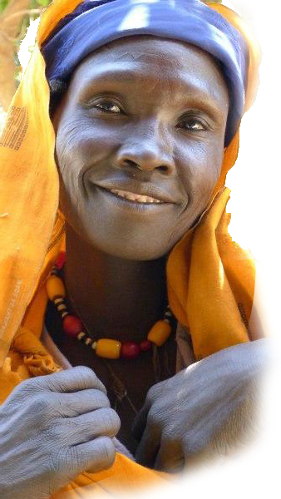
Psalm 86:9
BERTA, BENISHANGUL
People group፡ | BERTA
Location ፡ | WEST ETHIOPIA
Population፡ | 300,000
Main Language ፡ | BERTA
Main Religion፡ | ISLAM
Christian % ፡ | 2.00%
Evangelical % ፡ | 0.10%
Bible ፡ | PORTION
Jesus Film ፡ | YES

Slide 24
Psalm 77:13-14
HARARI
People group፡ | Harari
Location ፡ | East Ehiopia
Population፡ | 49,000
Main Language ፡ | Harari
Main Religion፡ | Islam
Christian % ፡ | 0.30%
Evangelical % ፡ | 0.05%
Bible ፡ | Portion
Jesus Film ፡ | No

Slide 25
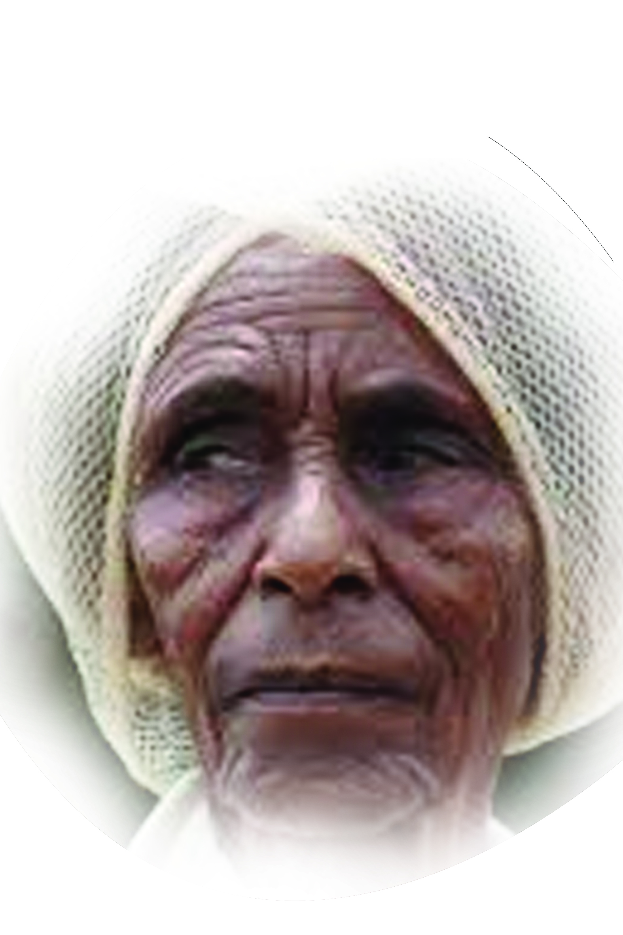
Psalm 72:8-11
KE’BEENA
People group፡ | Ke’beena
Location ፡ | South Ethiopia
Population፡ | 84,000
Main Language ፡ | Ke’beena
Main Religion፡ | Islam
Christian % ፡ | 3.00%
Evangelical % ፡ | 1.07%
Bible ፡ | Portion
Jesus Film ፡ | No

Slide 26
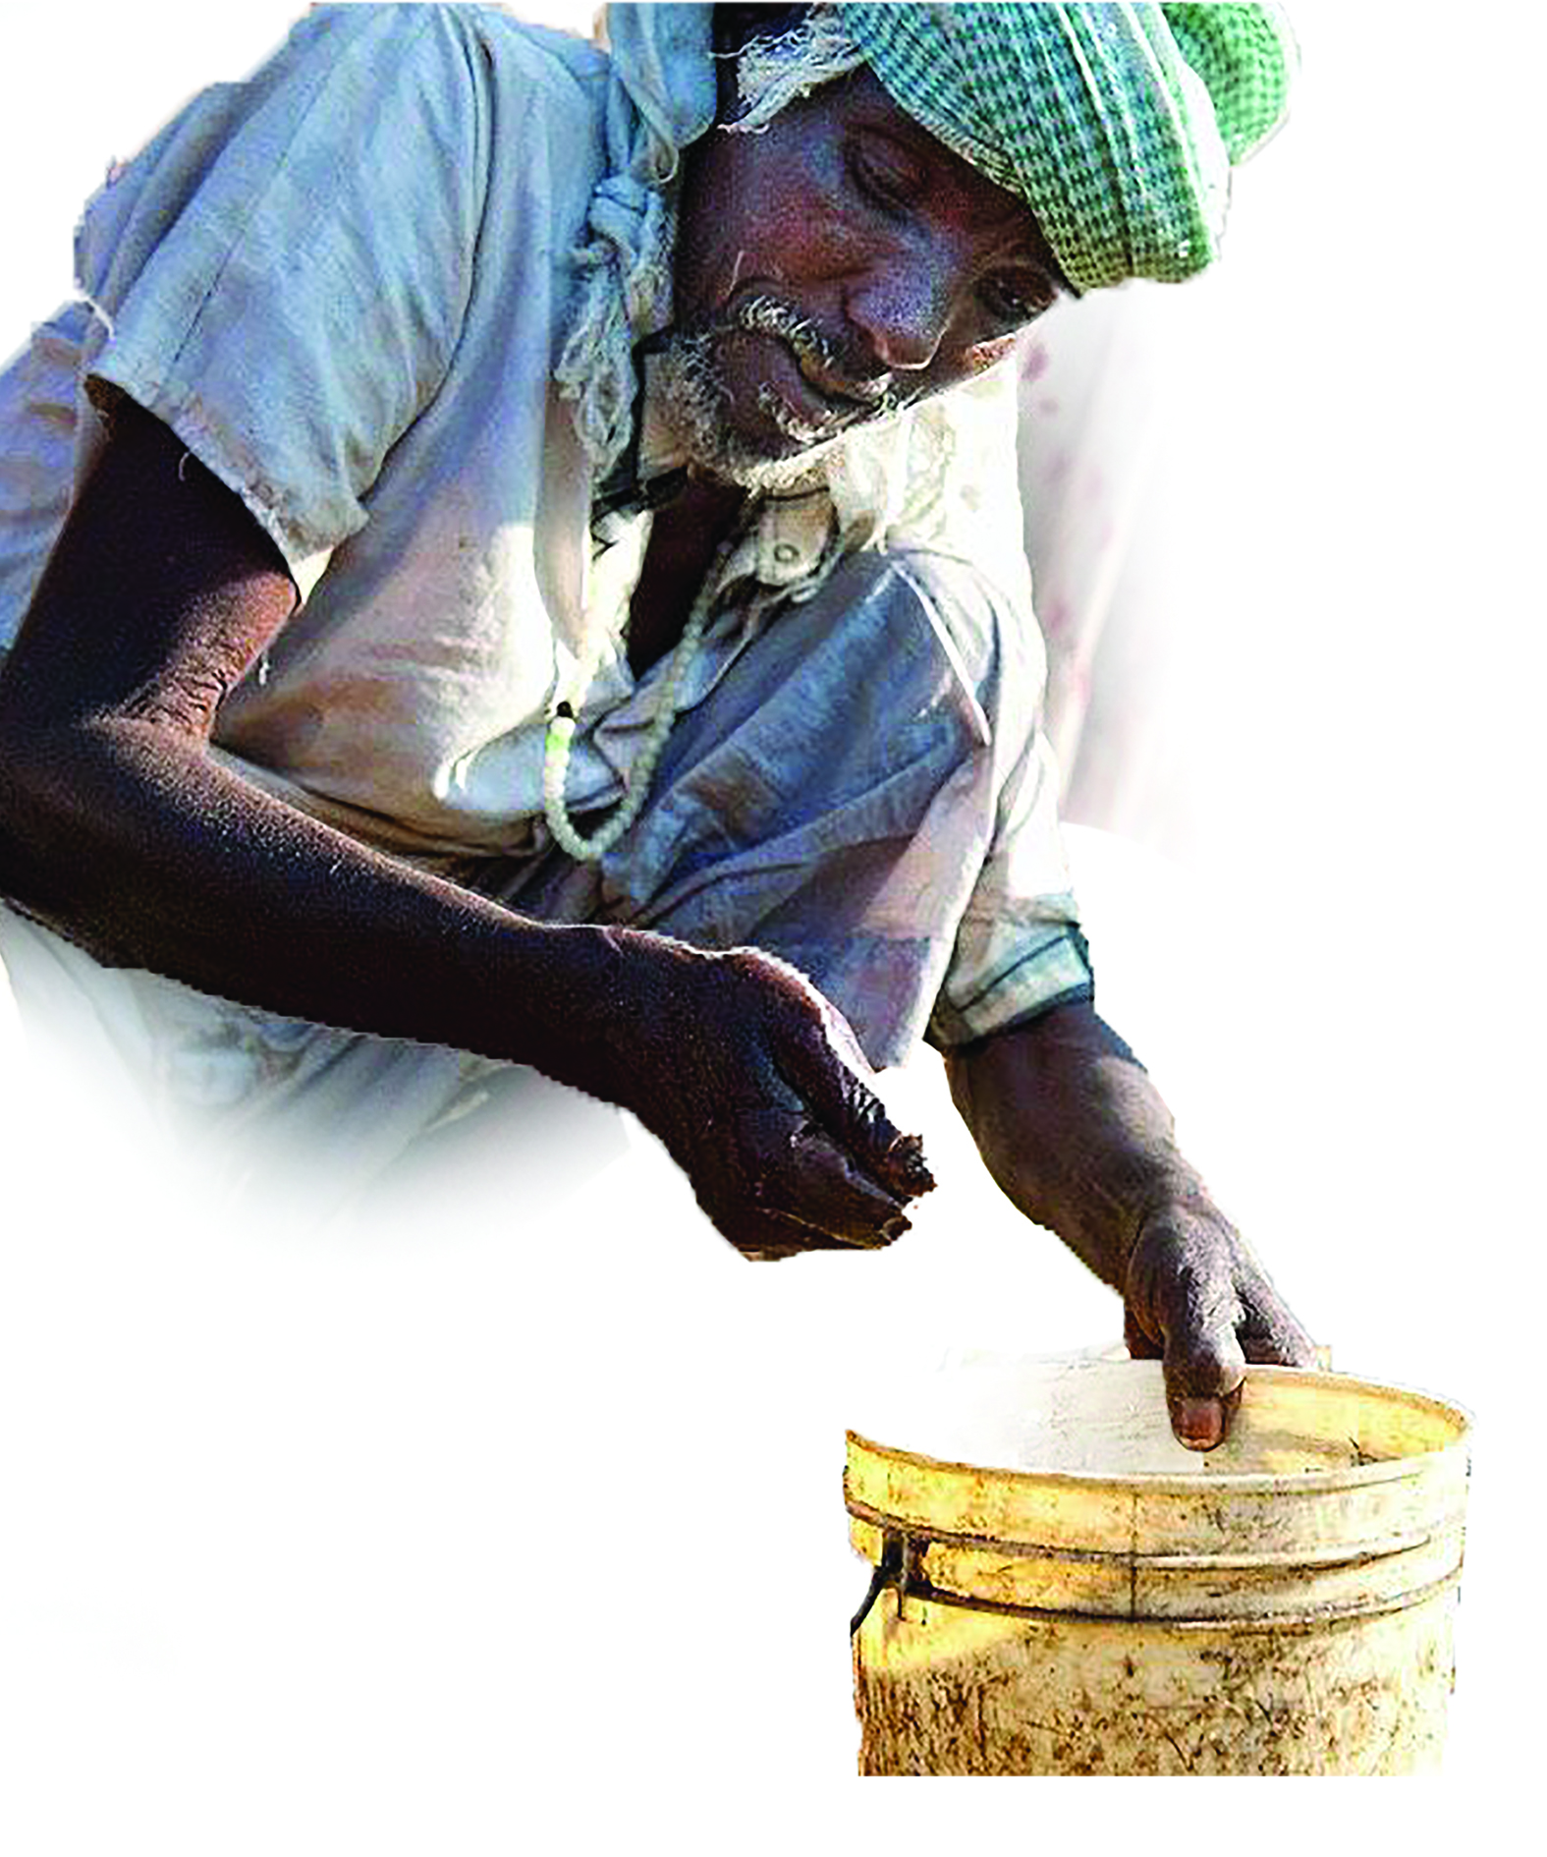
WEITO
People group፡ | WEITO PEOPLE
Location ፡ | NORTH WEST ETHIOPIA
Population፡ | 2,000
Main Language ፡ | AMHARIC
Main Religion፡ | ISLAM
Christian % ፡ | 4.40%
Evangelical % ፡ | 0.67%
Bible ፡ | YES
Jesus Film ፡ | YES
PSALM 67:1-7

Slide 27
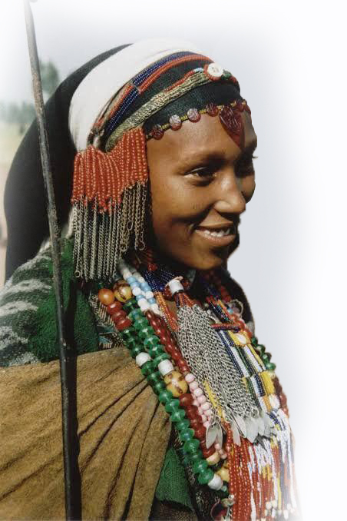
BALE OROMO
People group፡ | BALE OROMO
Location ፡ | SOUTH EAST ETHIOPIA
Population፡ | 2,034,000
Main Language ፡ | OROMIFA (BORONA-GUJI-ARISI)
Main Religion፡ | ETHINIC RELIGION (GEDA CULTURE)
Christian % ፡ | 1.50%
Evangelical % ፡ | 0.07%
Bible ፡ | YES
Jesus Film ፡ | YES
PSALM 66:1-8

Slide 28
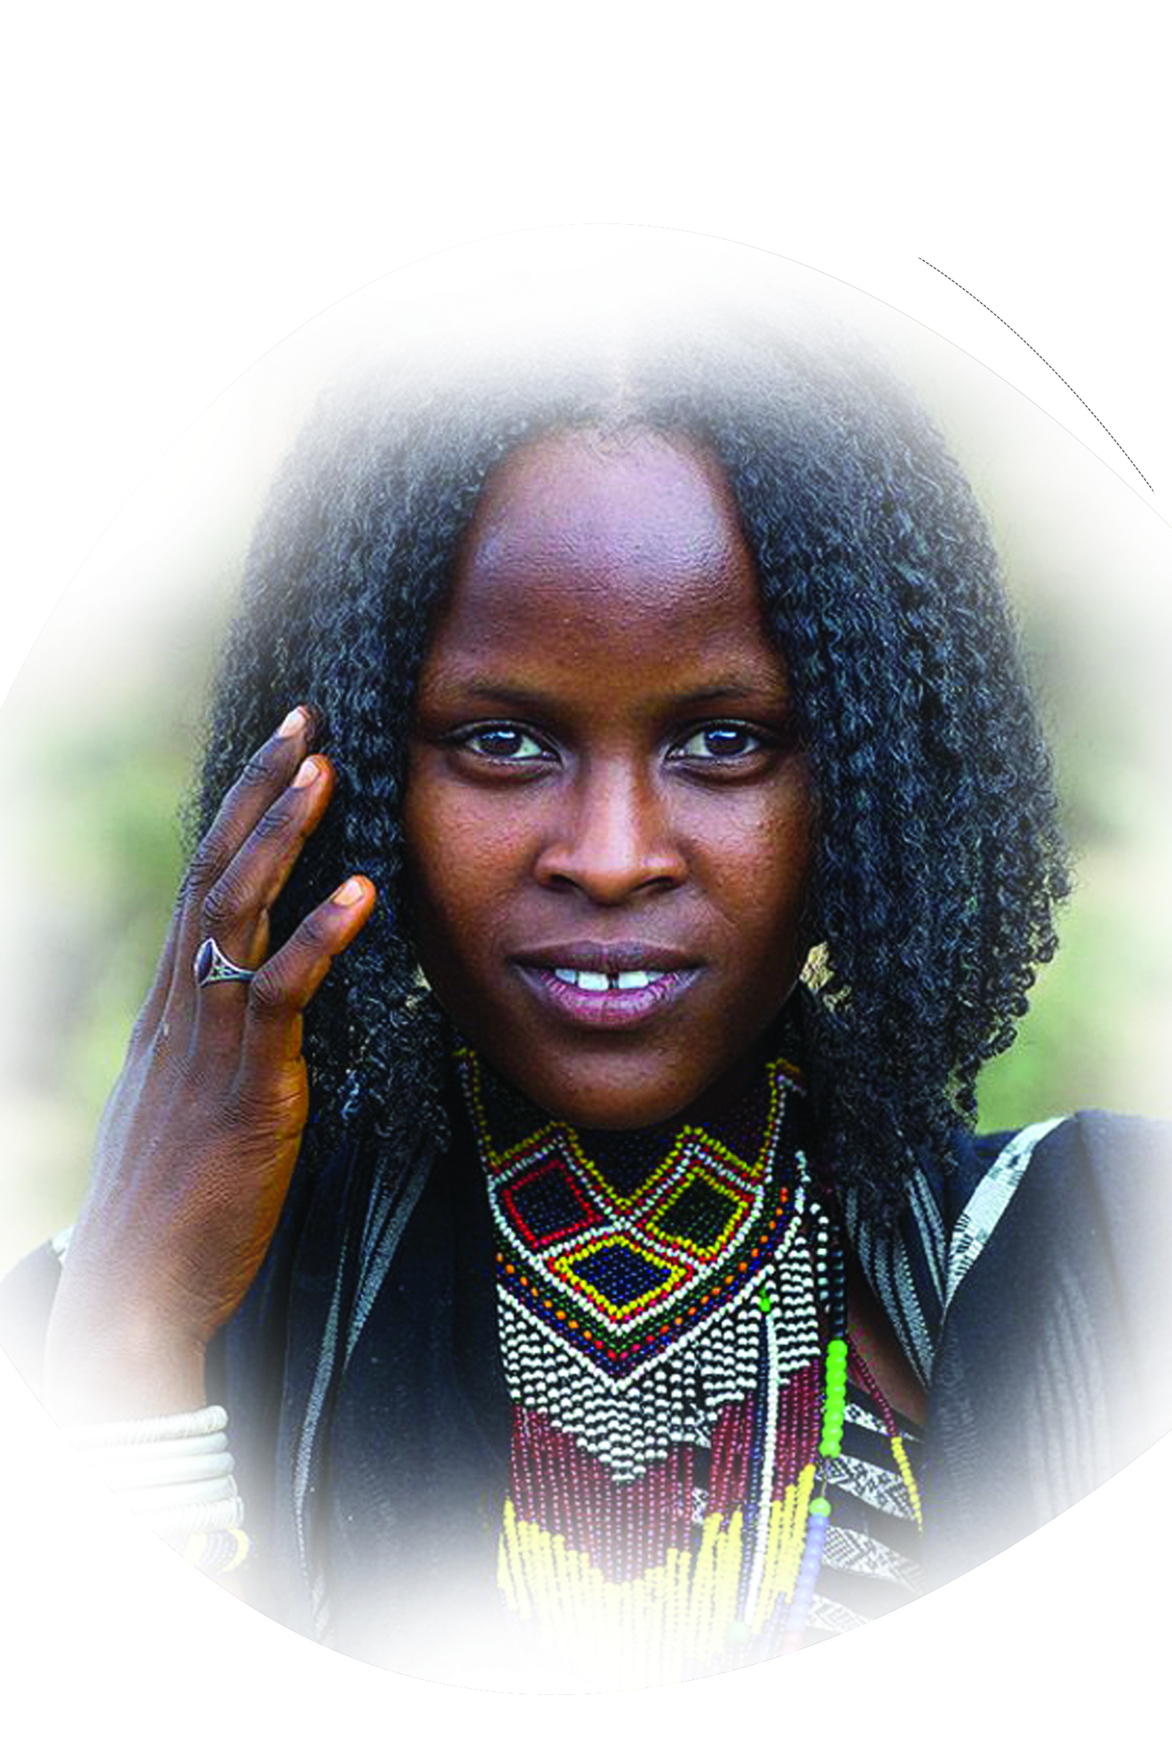
PSALM 57:9
BORONA OROMO
People group፡ | BORONA OROMO
Location ፡ | SOUTH ETHIOPIA
Population፡ | 1,359,000
Main Language ፡ | OROMIFA (BORONA-GUJI-ARISI)
Main Religion፡ | ETHINIC RELIGION (GEDA CULTURE)
Christian % ፡ | 4.00%
Evangelical % ፡ | 1.30%
Bible ፡ | YES
Jesus Film ፡ | YES

Slide 29
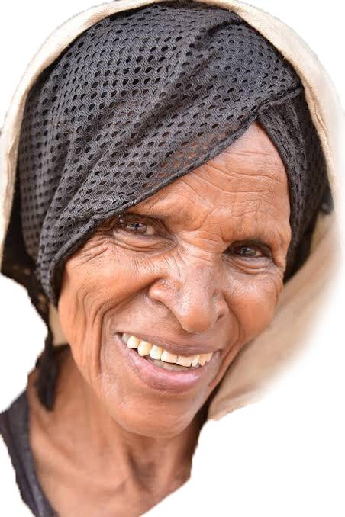
JIMMA OROMO
People group፡ | JIMMA OROMO
Location ፡ | SOUTH WEST ETHIOPIA
Population፡ | 3,553,000
Main Language ፡ | OROMIFA
Main Religion፡ | ISLAM
Christian % ፡ | 2.00%
Evangelical % ፡ | 1.30%
Bible ፡ | YES
Jesus Film ፡ | YES
PSALM 47:1-9

Slide 30
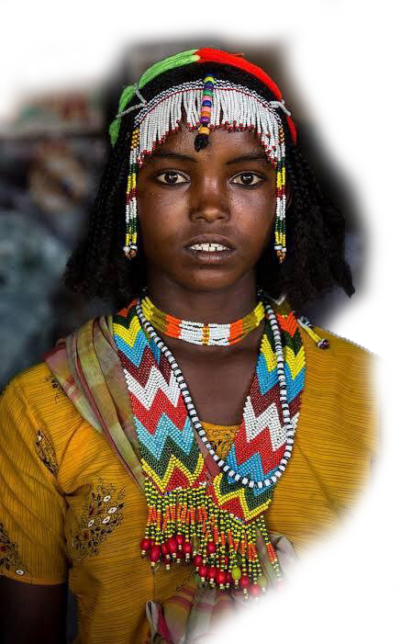
PSALM 45:17
YEJU OROMO
People group፡ | YEJU OROMO
Location ፡ | NORTH EAST ETHIOPIA
Population፡ | 563,000
Main Language ፡ | OROMIFA
Main Religion፡ | ISLAM
Christian % ፡ | 1.30%
Evangelical % ፡ | 0.40%
Bible ፡ | YES
Jesus Film ፡ | YES

Slide 31
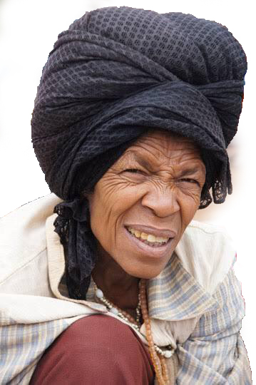
SILTE’
People group፡ | SILTE’
Location ፡ | SOUTH ETHIOPIA
Population፡ | 1,496,000
Main Language ፡ | SILTE’
Main Religion፡ | ISLAM
Christian % ፡ | 2.00%
Evangelical % ፡ | 0.09%
Bible ፡ | PORTION
Jesus Film ፡ | NO
PSALM 22:27-28

Slide 32
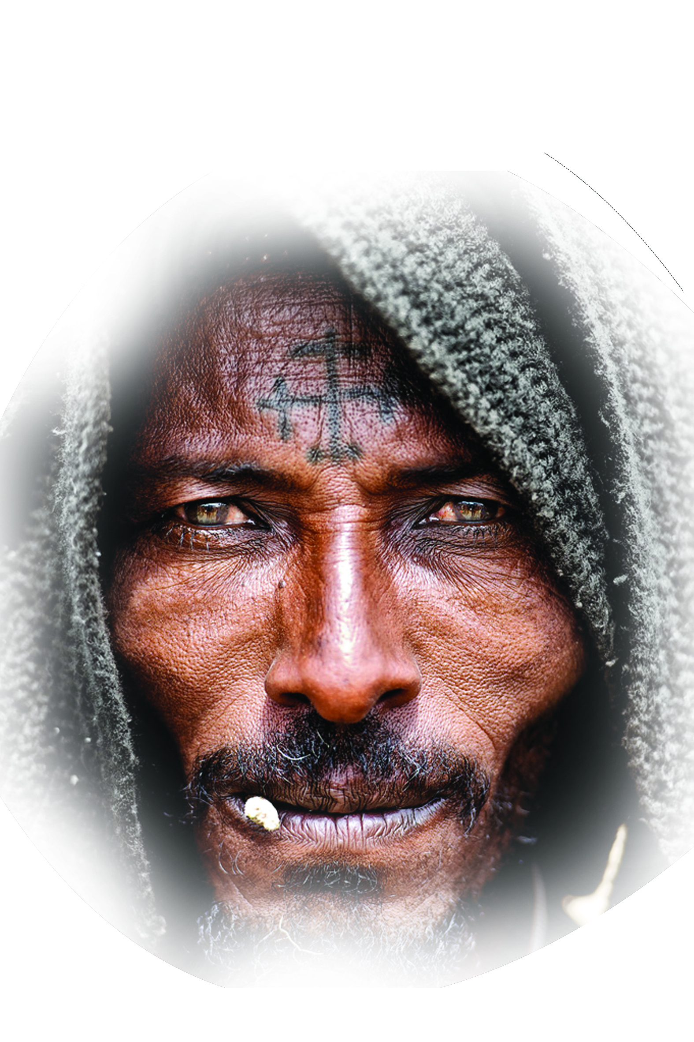
Rom 1፥5
E’ROB
People group፡ | E’rob
Location ፡ | North Ethiopia
Population፡ | 33,407
Main Language ፡ | Saho, Tigrigna
Main Religion፡ | Christian
Christian % ፡ | 85.6%
Evangelical % ፡ | 0.6%
Bible ፡ | No
Jesus Film ፡ | No

Slide 33
BEJA BEDEWI
People group፡ | BEJA BEDEWI
Location ፡ | SUDAN
Population፡ | 2,322,000
Main Language ፡ | BEDAWIT
Main Religion፡ | ISLAM
Christian % ፡ | 0%
Evangelical % ፡ | 0%
Bible ፡ | NO
Jesus Film ፡ | NO
Gal. 3፥8

Slide 34
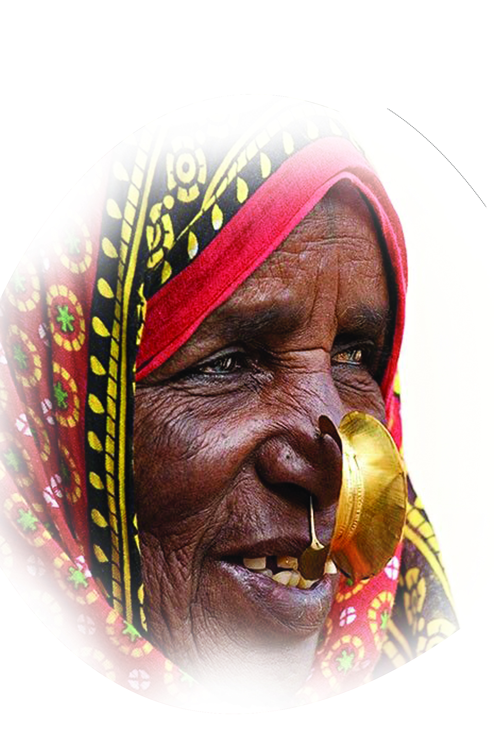
NARA
People group፡ | NARA
Location ፡ | ERTIREA
Population፡ | 82, 000
Main Language ፡ | NARA
Main Religion፡ | ISLAM
Christian % ፡ | 4.5%
Evangelical % ፡ | 1.8%
Bible ፡ | NO
Jesus Film ፡ | NO
1John 2፥2

Slide 35
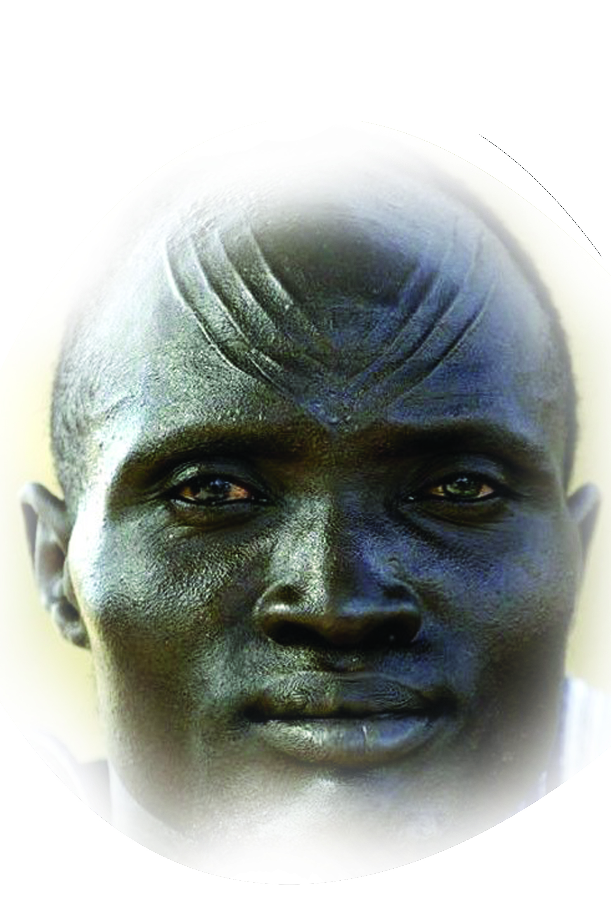
PSALM. 9፥11
SHILLUK
People group፡ | SHILLUK
Location ፡ | SOUTH SUDAN
Population፡ | 3,630
Main Language ፡ | SHILUK
Main Religion፡ | ETHINIC RELIGION
Christian % ፡ | 40%
Evangelical % ፡ | 2%
Bible ፡ | NO
Jesus Film ፡ | NO

Slide 36
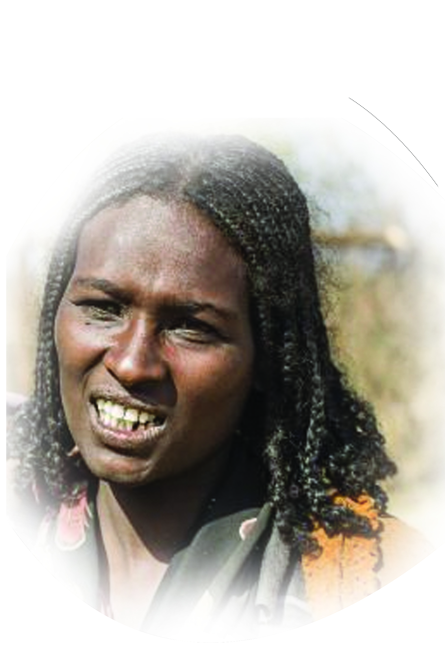
ZAY
People group፡ | ZAY
Location ፡ | CENTRAL ETHIOPIA
Population፡ | 28,000
Main Language ፡ | ZAY
Main Religion፡ | CHRISTIAN
Christian % ፡ | 80%
Evangelical % ፡ | 0.65%
Bible ፡ | NO
Jesus Film ፡ | NO
ISA. 52፥10

Slide 37
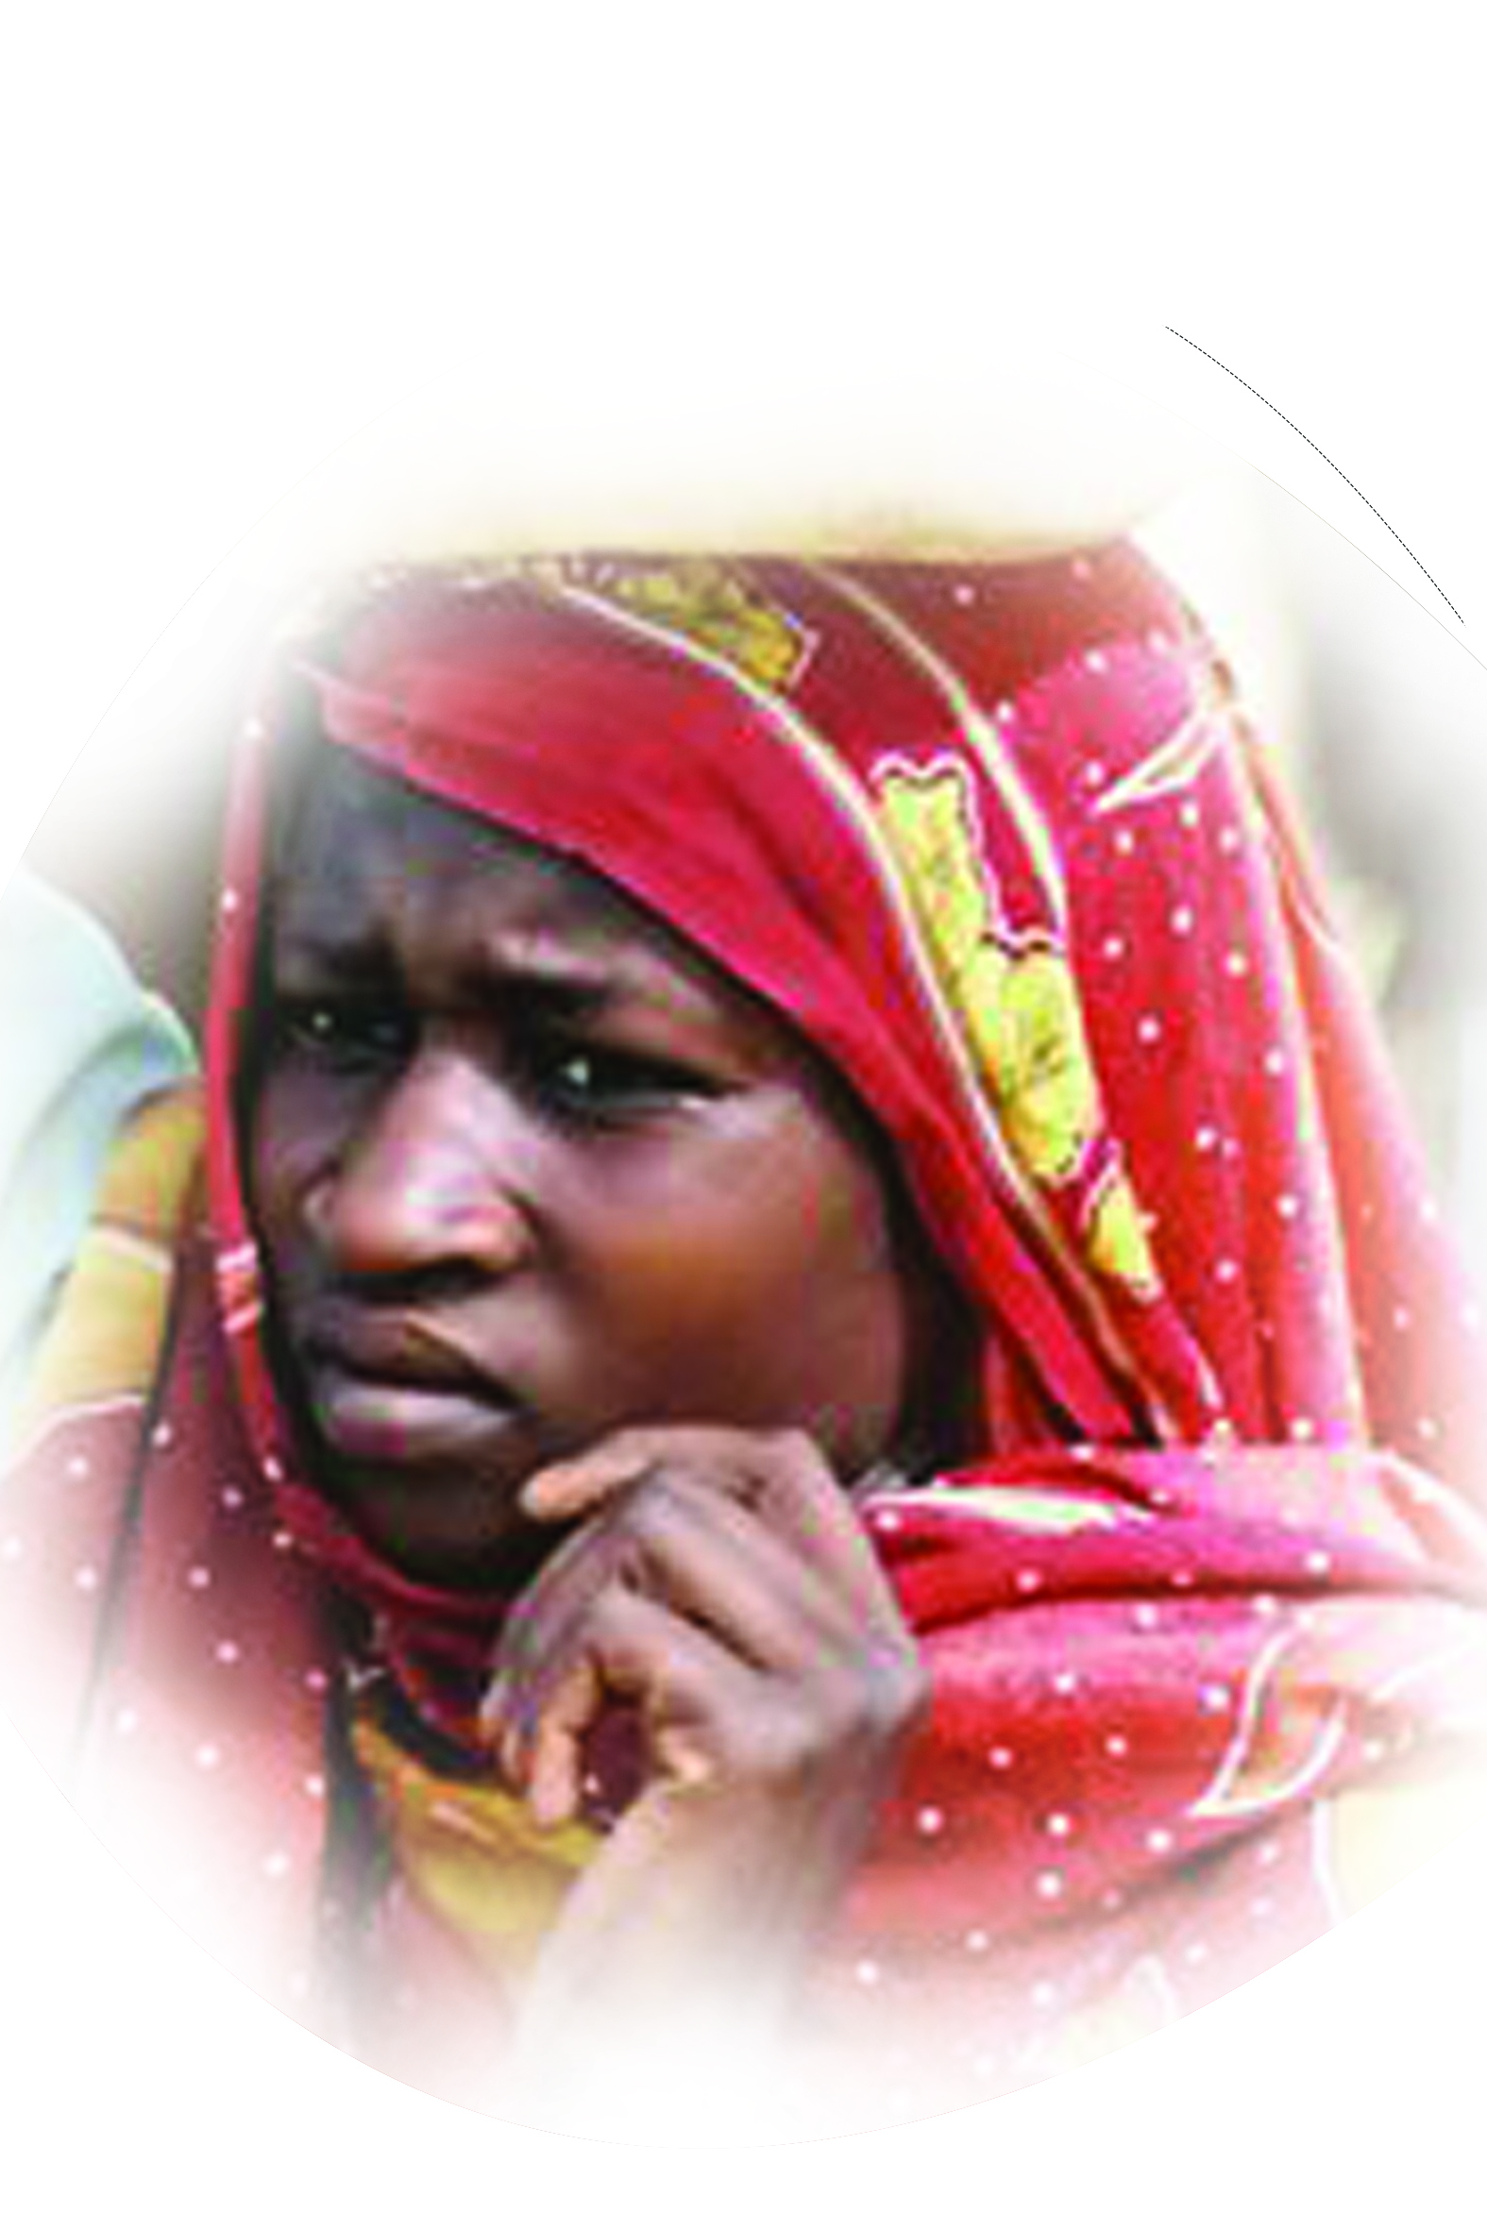
FUR, FOROK
People group፡ | FOROK
Location ፡ | SUDAN
Population፡ | 1,021,000
Main Language ፡ | FUR
Main Religion፡ | ISLAM
Christian % ፡ | 0%
Evangelical % ፡ | 0%
Bible ፡ | PORTION
Jesus Film ፡ | YES
PSALM 18:49

